Slide 1
Caucasian State Nature Biosphere Reserve
Gymnasium N23, Krasnodar, Russia
Teacher: Helen Savitskaya
Pupil: Yevgeniy Sorokin

Slide 2
The CONTENTS:
Map and Boarders
General Characteristics
Mountain Peaks and Caves
Rivers and Lakes
Flora and Fauna
Resorts
Winter Olympics
Environmental Protection

Slide 3
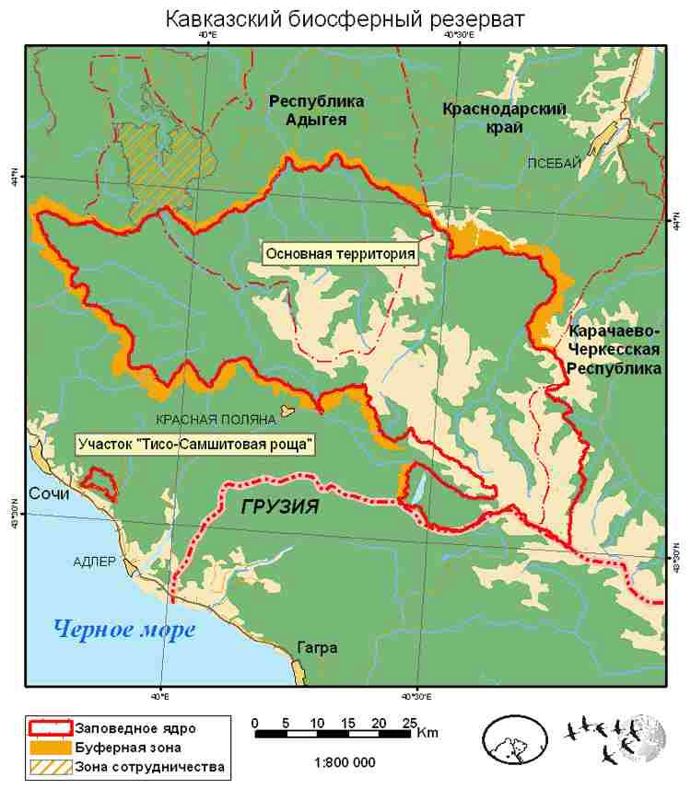
Map and description
Caucasian State Biosphere Reserve is located on the northern and southern slopes of the Western Caucasus, on the territory of Krasnodar Territory, the Republic of Adygei and the Karachaevo-Cherkessky Republic. The Sochi National Park is adjacent to its southern border.
Border of the Reserve -
Caucasian State Biosphere Reserve is located on the northern and southern slopes of the Western Caucasus, on the territory of Krasnodar Territory, the Republic of Adygei and the Karachaevo-Cherkessky Republic. The Sochi National Park is adjacent to its southern border.

Slide 4
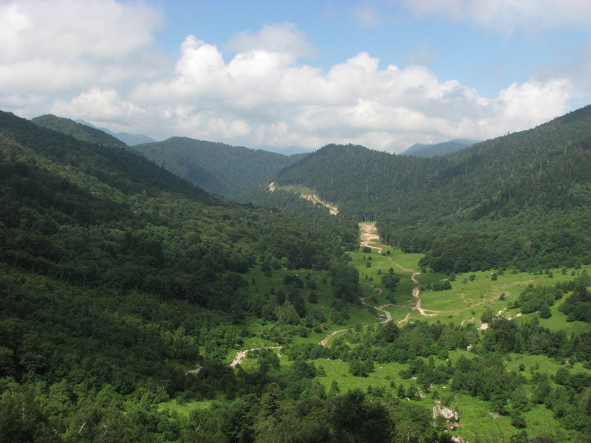
Caucasian State Biosphere Reserve is the largest protected territory of Caucasian Isthmus and the second large in Europe. Its history has started even before it got an official status in 1888 as a place for Kuban Hunting for the royal family.
Area of the Reserve - 280,335 hectares.

Slide 5
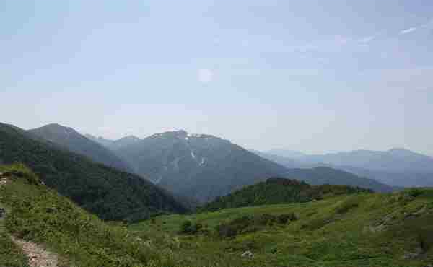
The highest of the peaks is Tsakhvoa (3345 m).

Slide 6
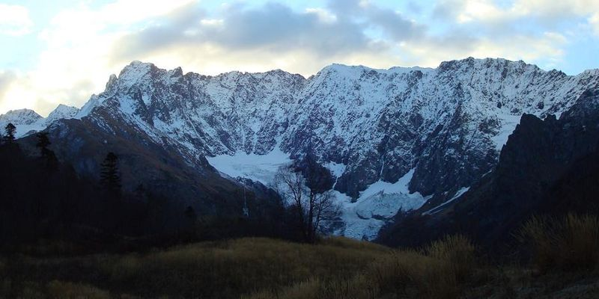
Glaciers are common; there are 60 of them, the largest (1.8 square kilometers) is on Mt. Pseashkho.

Slide 7
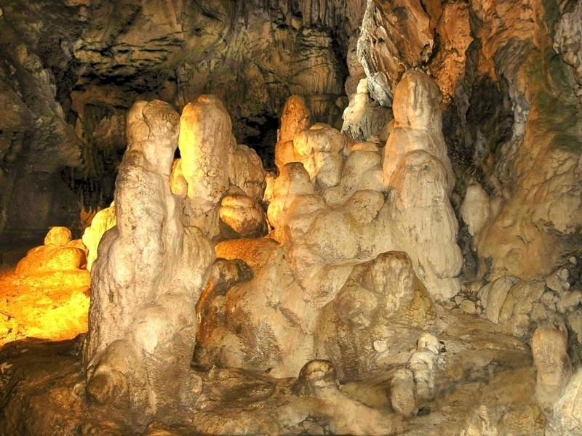
There are many caves in the Reserve, especially in the Lagonak plateau. There are 130 of them.

Slide 8
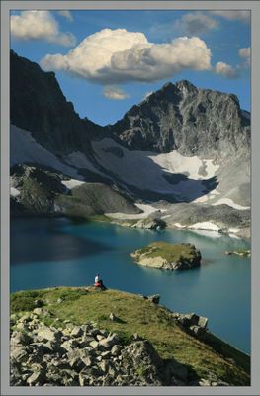
The reserve is especially unique due to its lakes; there are 120 of them, with the largest being Lake Bezmolvia (Silent Lake) with a water surface area of 200 thousand square meters. Lakes Khuko, Kardyvach, Inpsi, Goluboe and Atsetuk and others are especially beautiful.
Silent Lake
200 thousand km²

Slide 9
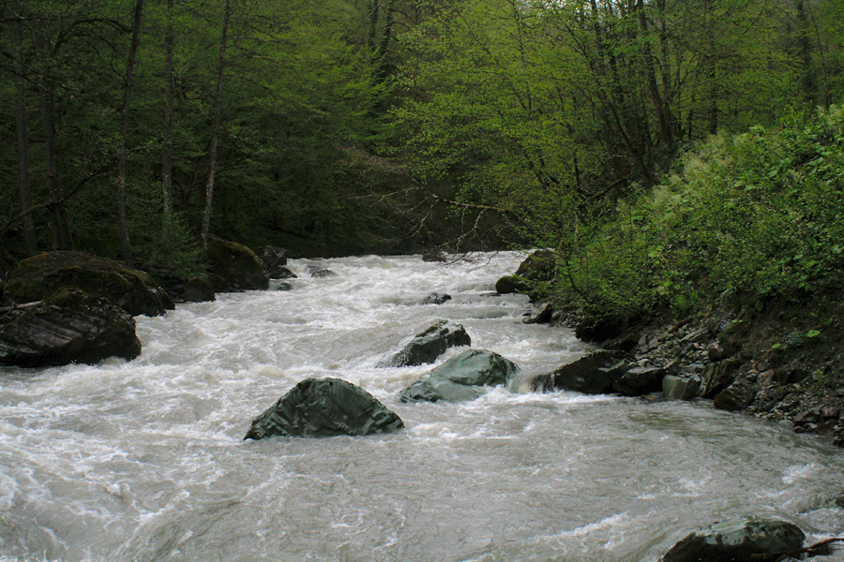
Rivers
The rivers of the reserve, the Mzymta, the Sochi, the Shakhe, the Belaya, the Malaya Laba are typical river streams with frequent waterfalls, narrow cliff gorges, narrows and canyons. The rivers supply pristine water not only for the tourist city of Sochi, but for many cities and towns of the region.
the Mzymta

Slide 10
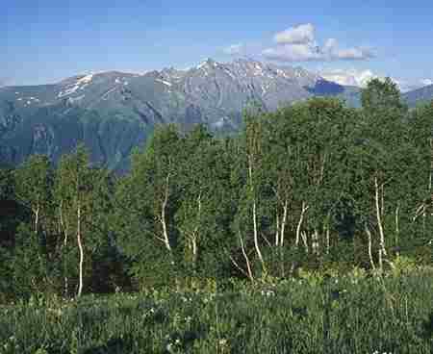
22% of the territory of the reserve is covered by forests. They are oak forests, alder forests , beech forests with hornbeam and chestnut forests. The forests of the reserve are the lungs of the tourist city Sochi.

Slide 11
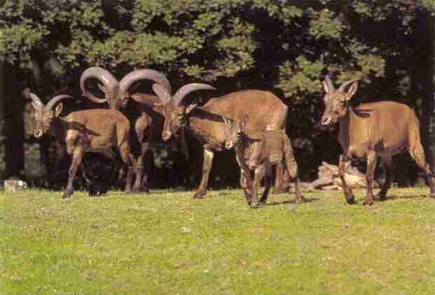
The Caucasus Reserve is rich in fauna. The mountain bison, Western Caucasus Goat, royal stag, brown bear, gazelle, bobcat, roe deer, wolf, wild boar and other animals live in the reserve.
Western Caucasus Goat

Slide 12
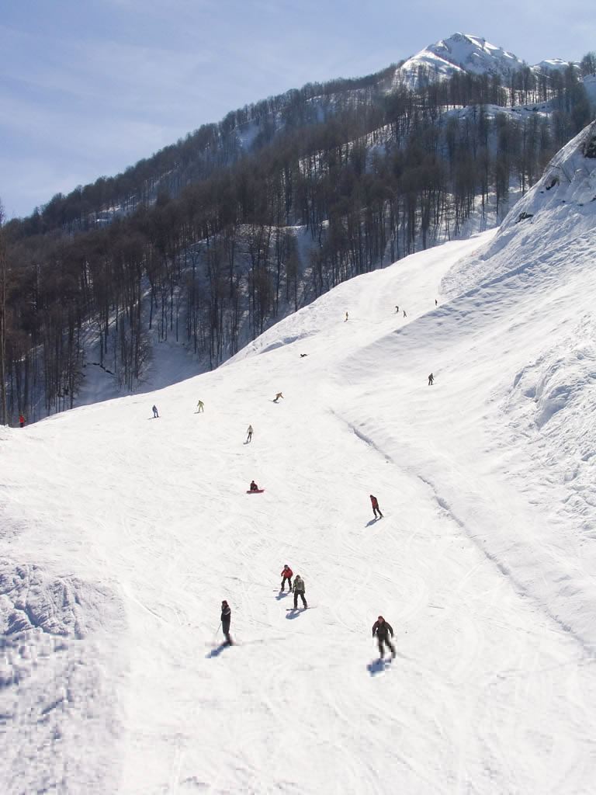
There is a ski resort
Krasnaya Polayana
located on the territory if the Reserve.

Slide 13
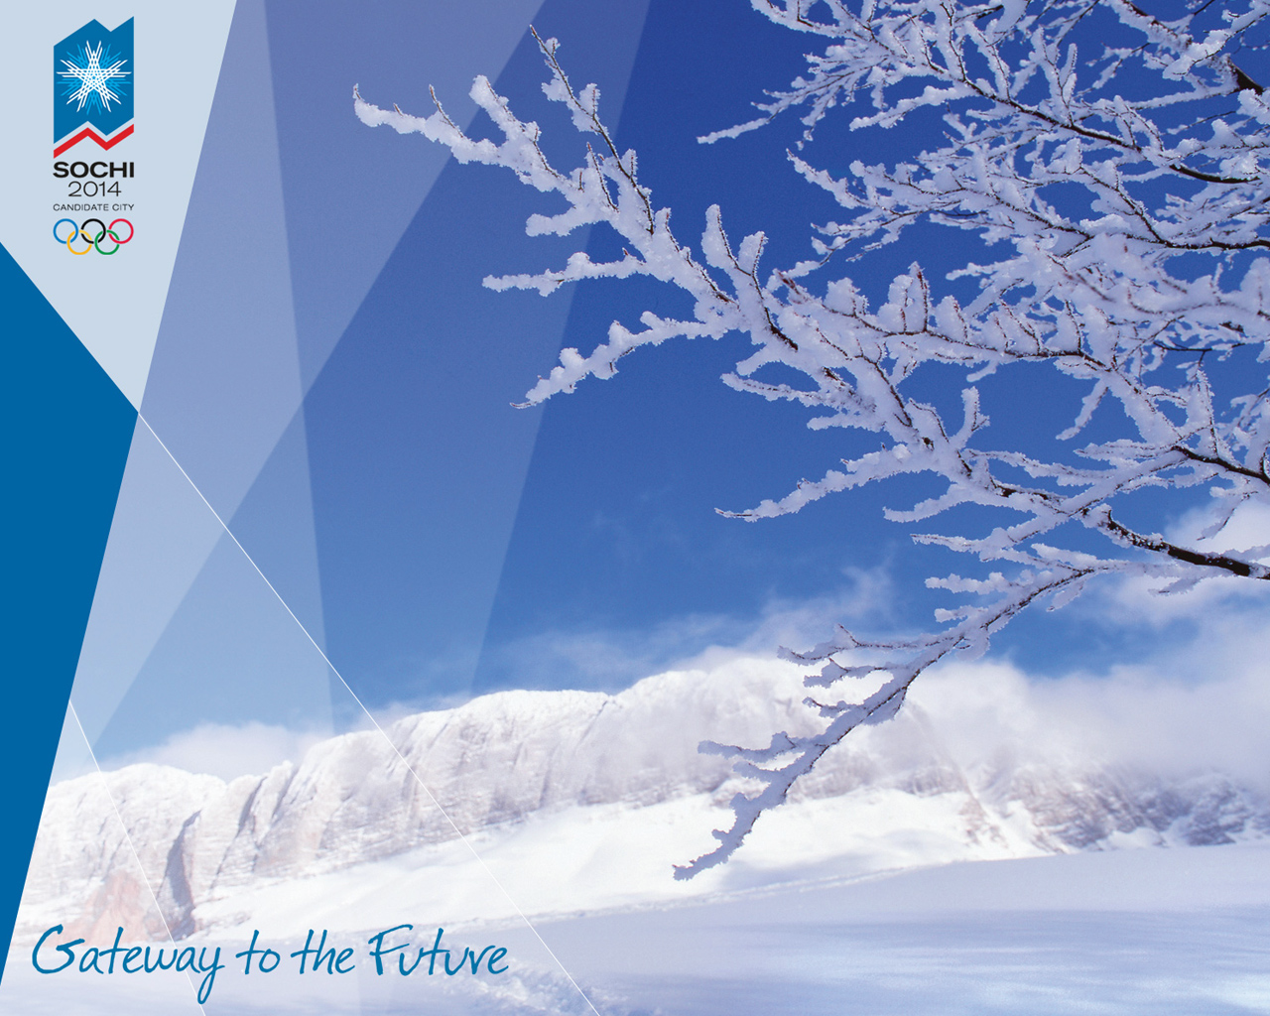
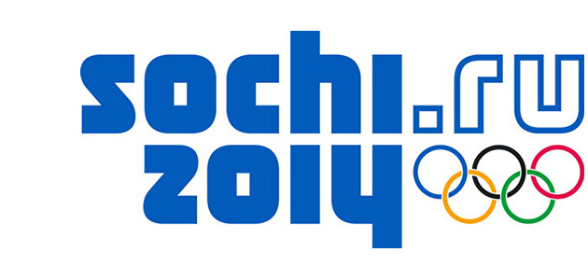
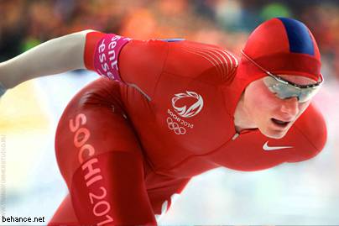
Krasnaya Polyana is slated to host the snow events (alpine and Nordic)
of the 2014 Winter Olympics in Sochi.
How to protect Reserve for future generations?

Slide 14
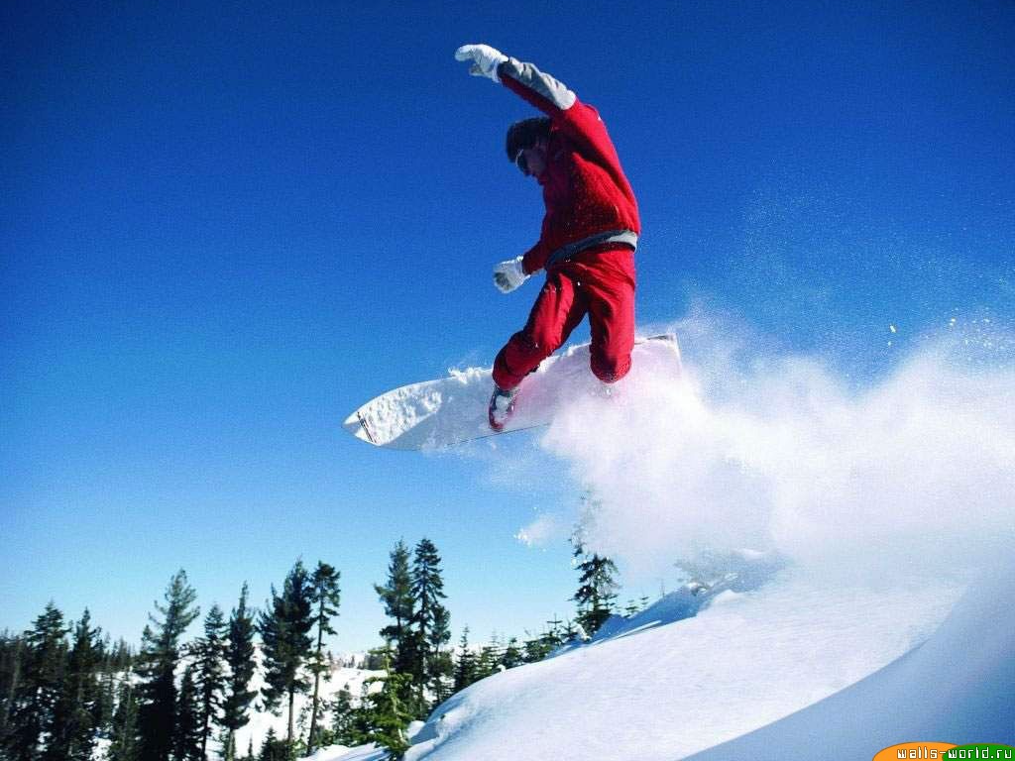
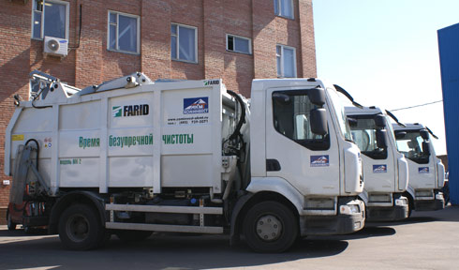
It has been planned, during the preparation for holding Winter Games of 2014,
to perform a number of interventions in order to introduce «zero waste» principle.

Slide 15
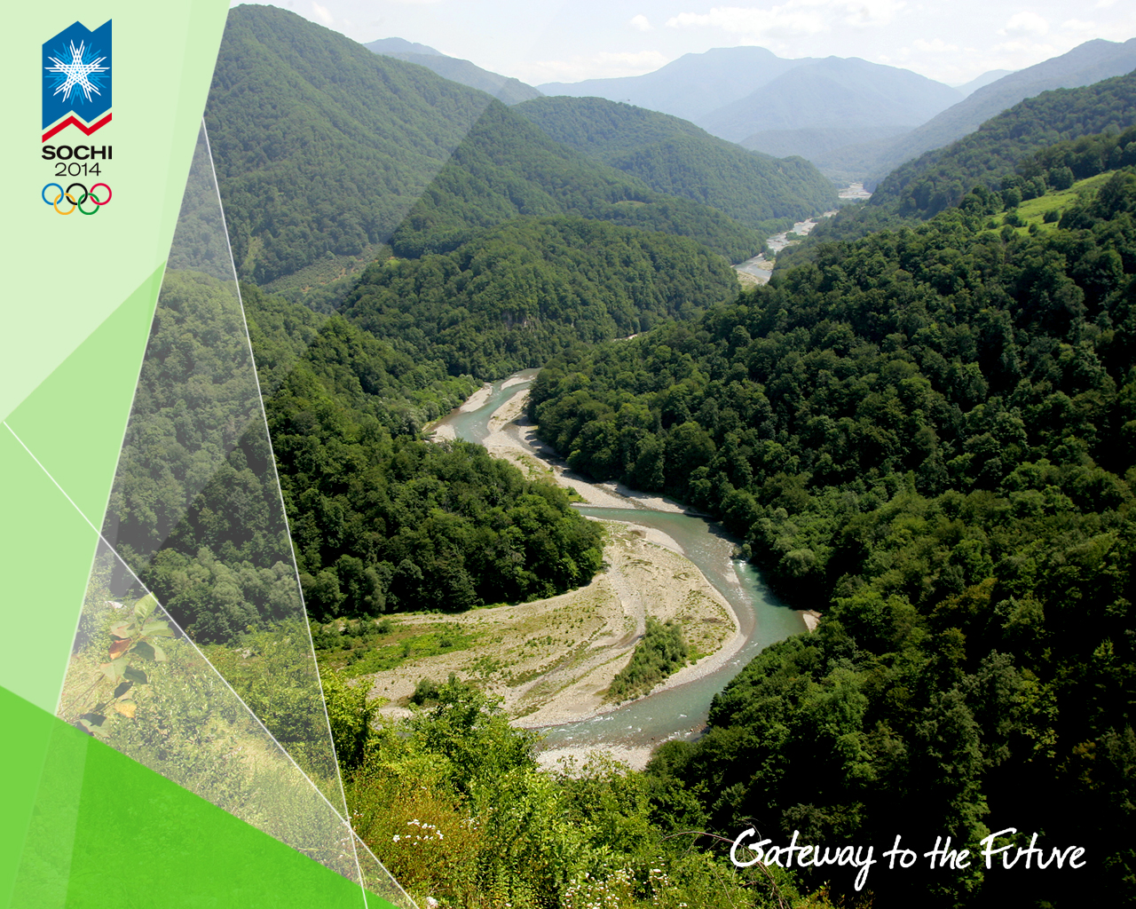
«Zero waste» principle implies not only reduced volumes of garbage but also recovery and recycling of used-up products. Implementation of «Zero waste games» dimension is based on generally avowed initiative 3R — Reuse, Reduce, Recycle.

