Slide 1
English on the Net

Slide 2
How much time do you spend on the Net? What do you do there? Do you only chat with your friends? Do you ever think that the Internet can help you in studying English?
It can be really a very useful tool in this process. Here you’ll find a lot of useful resources for practicing different skills.

Slide 3
Grammar

Slide 4
edufind.com
You can:
Take the free English language level test
View hundred's of English language learning resources (tests and quizzes, grammar topics, blogs, question and answer sections, video learning, a monthly email learning newsletter etc.)
Sign-up for free membership and join a huge international learning community (With a free membership you can track your improvement and keep your test scores, communicate with thousands of other members, post questions to our teachers and get special deals on software and e-books).
www.edufind.com/english/grammar/

Slide 5
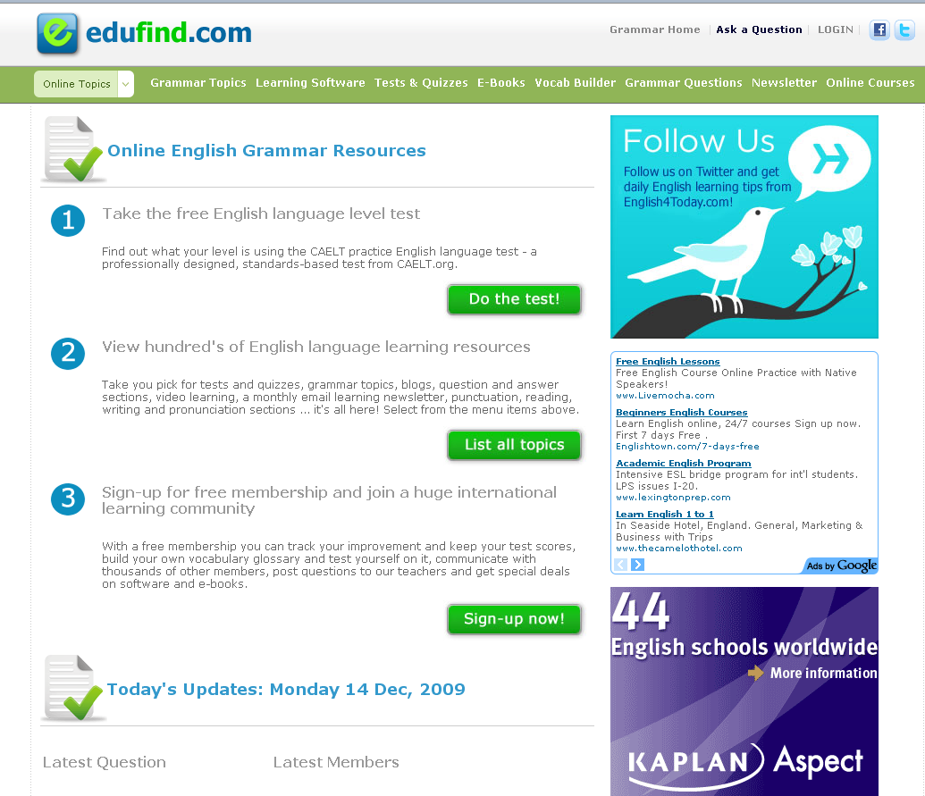

Slide 6
learnenglishfeelgood.com
This is an online grammar quizzes section - a good place to practice and improve your knowledge of English grammar. Many of these quizzes focus on topics that a lot of students often find difficult to understand. The quizzes come in three levels:
beginner
intermediate
advanced.
The topics covered include:
verb tenses
phrasal verbs
articles
prepositions
noun clauses, and much more.
www.learnenglishfeelgood.com/esl-english-grammar-exercises.html

Slide 7
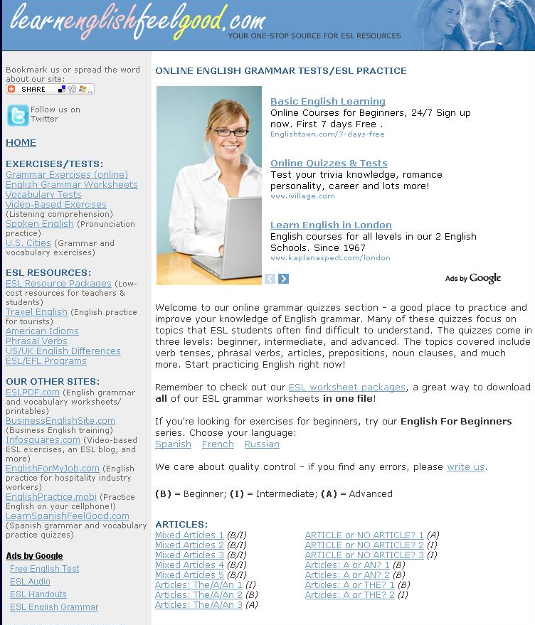

Slide 8
Oxford University Press
You can find different information to practice your grammar skills. First of all you choose one of tree levels: basic, intermediate, advanced. Then you will see sections:
Practice exercises
Listen and Speak
Read and write
Links
Choose one and start working!
www.oup.com/elt/global/products/practicegrammar/

Slide 9
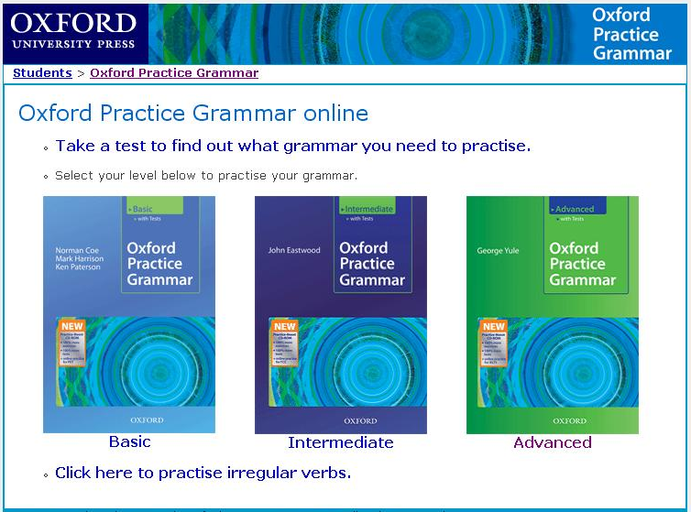

Slide 10
Vocabulary

Slide 11
vocabulary.co.il
“Vocabulary is Fun” is a leading vocabulary website worldwide with the best flash online word games. The vocabulary games include:
an online word search
an online crossword puzzle
hangman online.
Users choose the vocabulary list that the online word game will use.
www.vocabulary.co.il

Slide 12
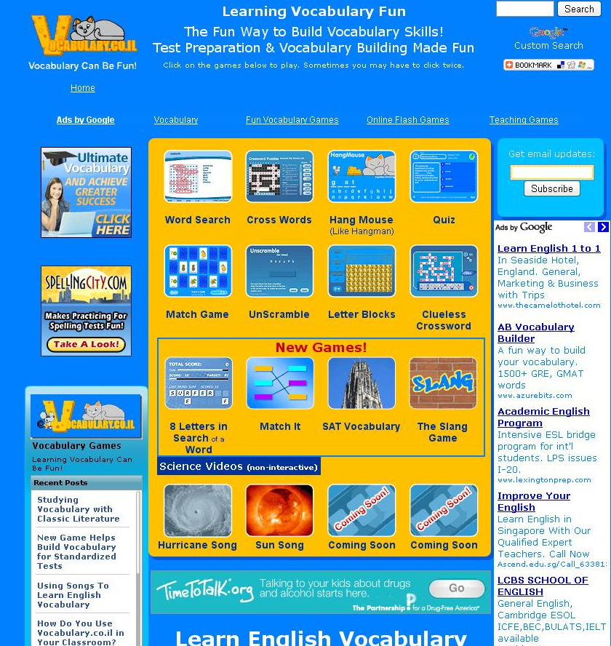

Slide 13
Activity for ESL students
There are different vocabulary activities such as Vocabulary Quizzes and Crossword Puzzles. Each activity is divided into different levels, so you can choose a suitable one for you.
www.a4esl.org

Slide 14
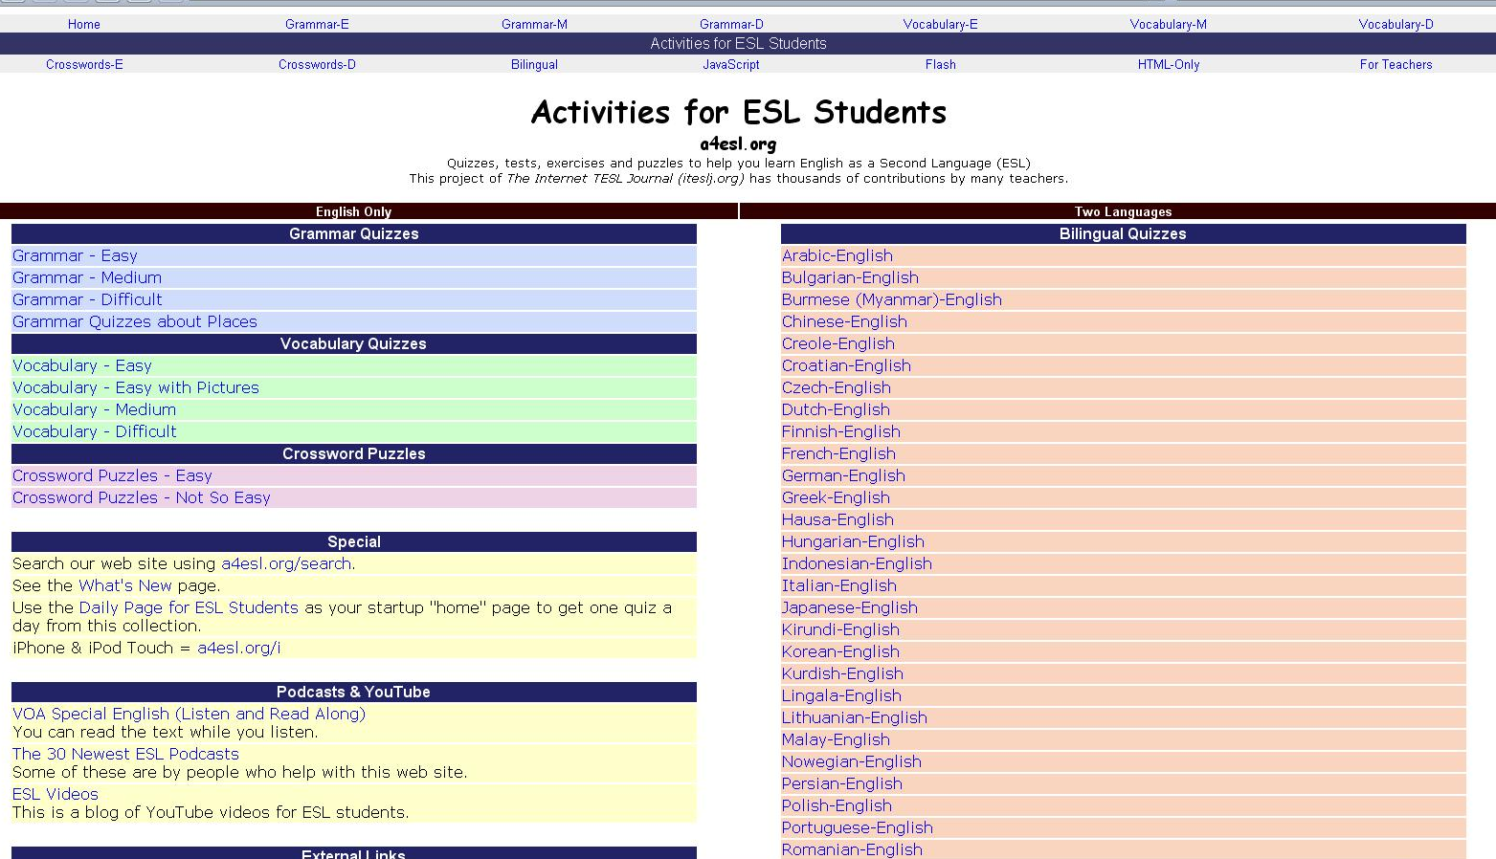

Slide 15
Reading

Slide 16
pearsonlongman.com
The reading tests provided here are:
a combination of multiple choice
short-answer
long-answer questions.
The short-answer and long-answer questions are designed to have your process the information in the passage, analyze it, and organize it for the answer. In this way, these practice questions test your analytical abilities, not just comprehension.
www.pearsonlongman.com/ae/marketing/sfesl/practicereading.html

Slide 17
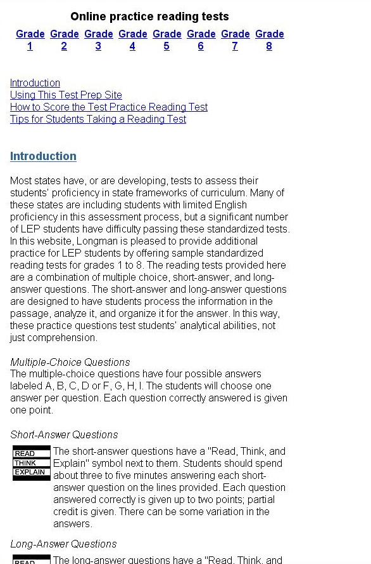

Slide 18
Interlink language center
The information in this site is organized this way:
Mini-stories with close exercises
Speed reading exercises
Extensive reading
Science reading
Read and listen
www.eslus.com/LESSONS/READING/READ.HTM

Slide 19
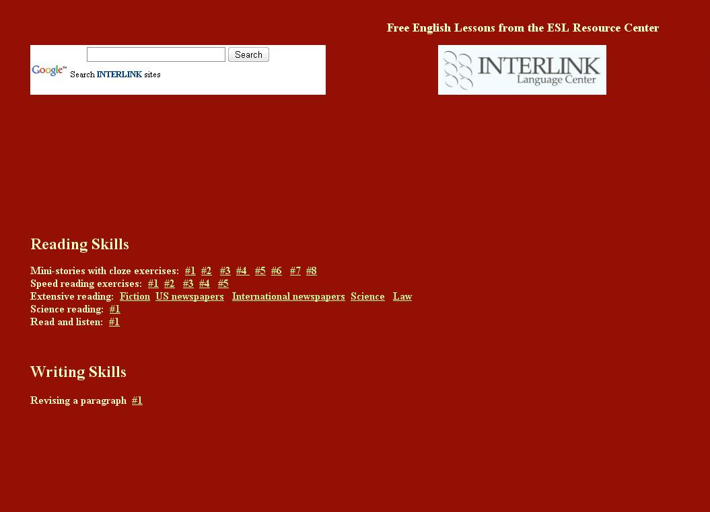

Slide 20
Listening

Slide 21
Elllo
The information is arranged here in different topics. On each page you’ll find an MP3 file, script and exercises that you can check online.
www.elllo.org/

Slide 22
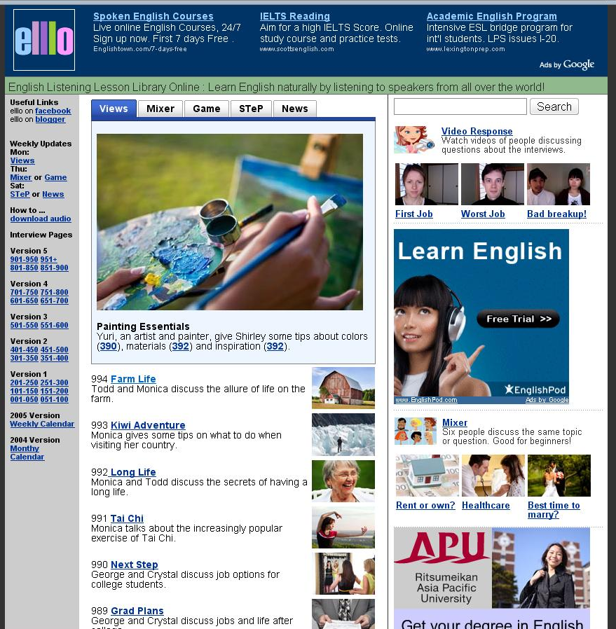

Slide 23
about.com
There are comprehension quizzes for listening skill improvement for beginner, intermediate and advanced English levels, podcasts. So you can improve you listening skills with RealAudio and listening strategies, practice you intonation and stress.
www.esl.about.com/od/englishlistening/English_Listening_Skills_and_ActivitiesEffective_Listening_Practice.htm

Slide 24
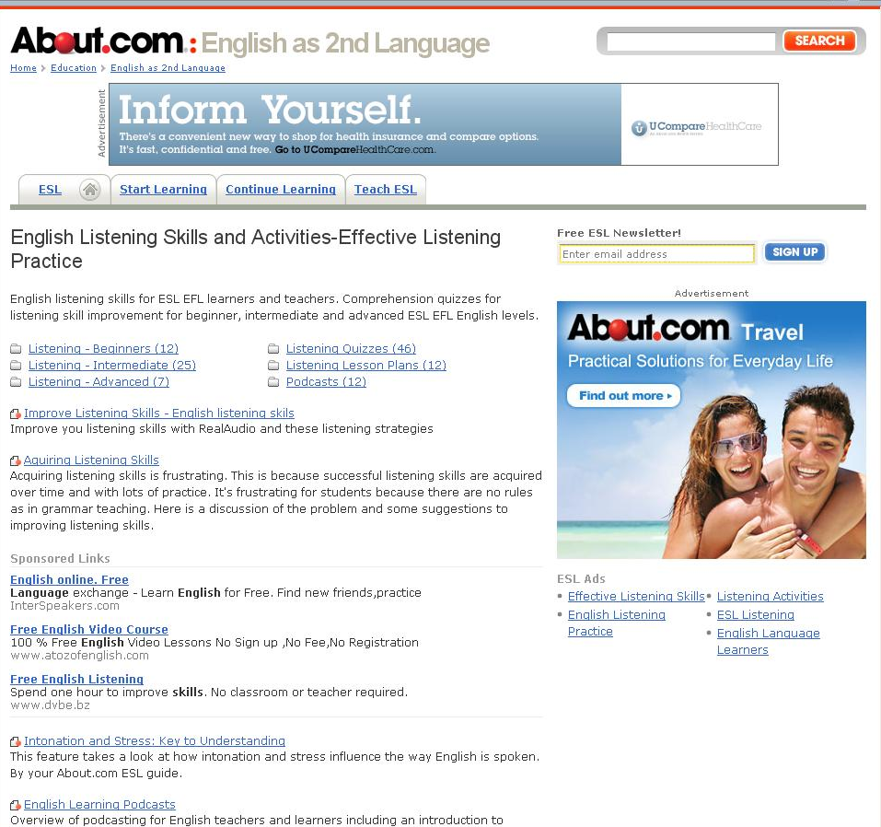

Slide 25
Writing

Slide 26
English Practice
This site provides information about all types of writing:
creative writing
essay writing
Letters
writing for business purposes etc.
www.englishpractice.com

Slide 27
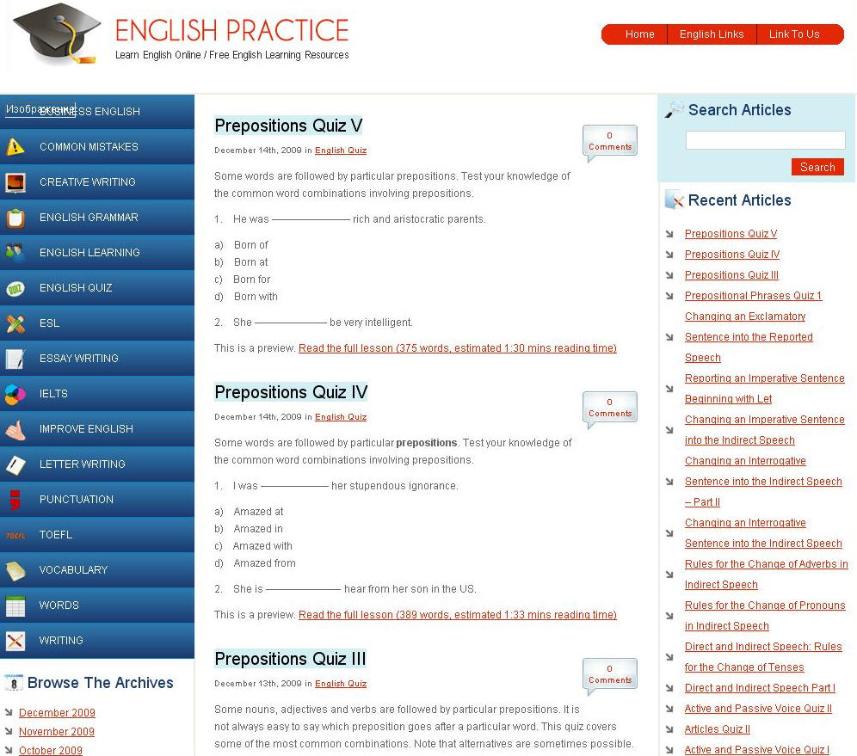

Slide 28
Guide to grammar & writing
This site is a kind of a guide to writing. There is a great rage of information and different levels (e.g. Word & Sentence Level, Paragraph Level, Essay & Research Paper Level).
grammar.ccc.commnet.edu/grammar/

Slide 29
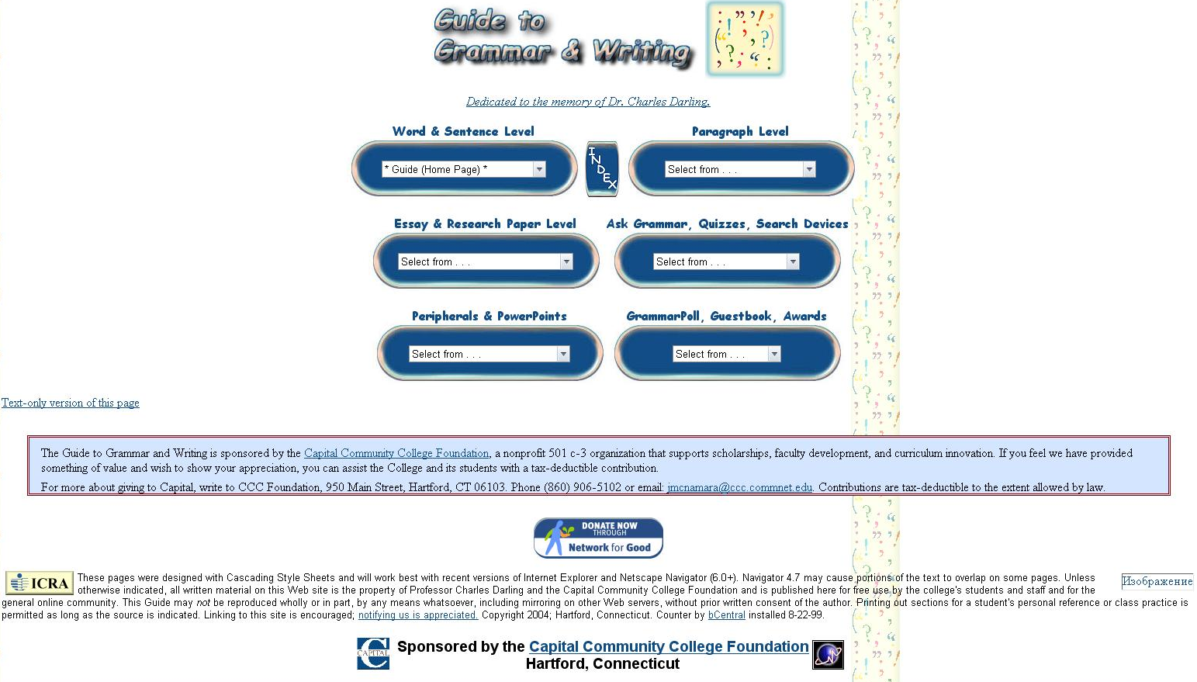

Slide 30
Speaking

Slide 31
EnglishClub.com
The creators of this site think that speaking is a very important skill to practice. But they also suppose that speaking to yourself can be "dangerous" because men in white coats may come and take you away! That is why you should make every effort possible to find somebody to speak with. You can practice speaking for different purposes.
www.englishclub.com/speaking/index.htm

Slide 32
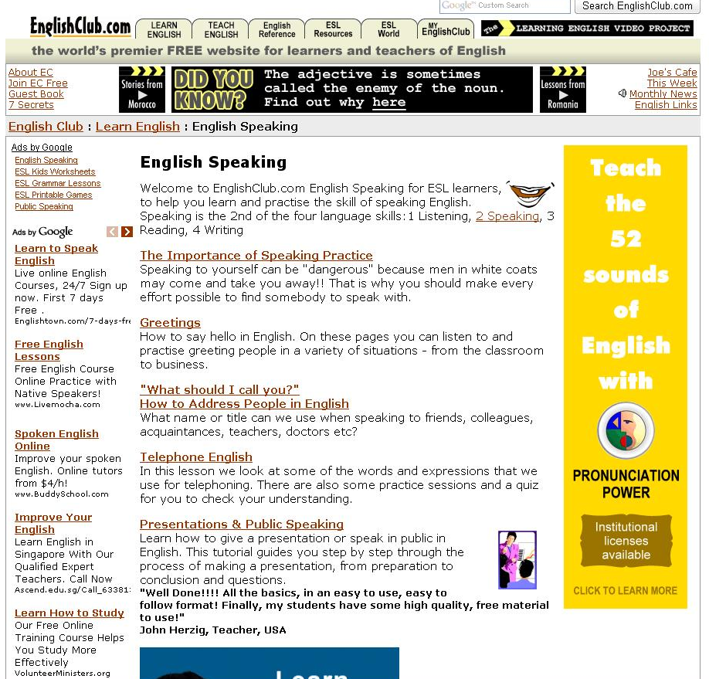

Slide 33
www.talkenglish.com/LessonDetails.aspx?ALID=615
The goal is to help you gain the ability to speak English fluently completely FREE!
Regular English Lessons (Learn what to say and how to say things in daily conversations.)
Business English Lessons (Increase fluency in professional business communication in an office setting.)
Travel English Lessons (Specifically created for people going to an English speaking country for vacation.)
Interview English Lessons (Prepare for any kind of interview conducted in English and gain confidence.)
Phrases and Idioms (Learn phrases and idioms that are hard to translate into a different language.)
Special Topics (Lessons on various topics for people living in the US or planning on moving to the US.)
English Listening Lessons (Improve your listening skills with fun questions and answers.)
Basics of English Grammar ( Build basic grammar skills pertaining to English speaking.)
www.talkenglish.com/LessonDetails.aspx?ALID=615

Slide 34
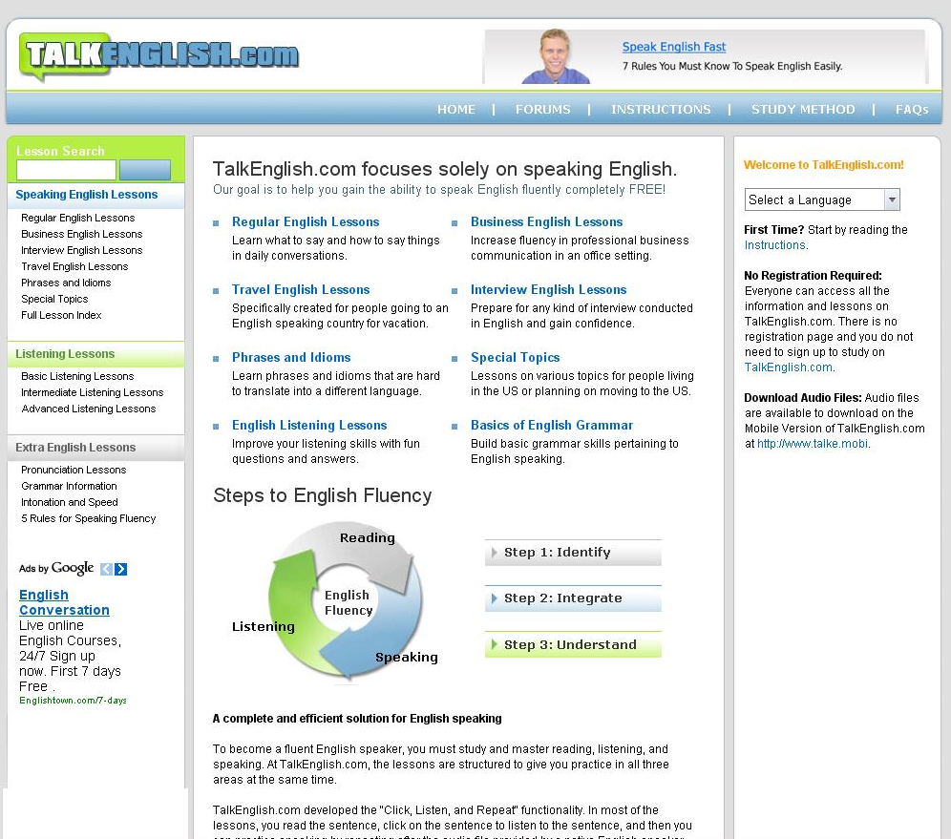

Slide 35
Grammar
www.edufind.com/english/grammar/
www.learnenglishfeelgood.com/esl-english-grammar-exercises.html
www.oup.com/elt/global/products/practicegrammar/
Vocabulary
www.vocabulary.co.il
www.a4esl.org
Reading
www.pearsonlongman.com/ae/marketing/sfesl/practicereading.html
www.eslus.com/LESSONS/READING/READ.HTM
Listening
www.elllo.org/
www.esl.about.com/od/englishlistening/English_Listening_Skills_and_ActivitiesEffective_Listening_Practice.htm
Writing
www.englishpractice.com
grammar.ccc.commnet.edu/grammar/
Speaking
www.englishclub.com/speaking/index.htm
www.talkenglish.com/LessonDetails.aspx?ALID=615

