Slide 1
Baby shower in India
Introduction

Slide 2
Essence of Baby Shower
7th month celebration – diverse ways of celebrating universal joys! – showering mom-to-be, baby and not to forget the dad-to-be with love and blessings.
Most cultures the world over, have ceremonies / celebrations before a baby is born. Mostly, all over the world these are celebrated in the 7th month of pregnancy (Usually the odd numbered months – 7th or 9th for good luck - but the 9th month might be too late). There are many different ways of celebrating, but the universal essence is to make the mom-to-be feel special and even pamper her.

Slide 3
The essence of the traditional Indian celebration (unity in diversity)
India being a vast and diverse sea of humanity has many different customs and celebrations in different areas—Godh Bharai (North Indian Hindus), Valakaappu (Tamil Hindus) and Seemandham (South Indian Hindus) to name a few. Maharashtra, Gujarat, Bengal etc. also have their own twists on these ceremonies.
The common thread in India is to bless the expecting mom and pray for the well being of the mother and the baby. It is the mom-to-be who is showered with blessings and bounty - cash, clothes or even jewellery - a sort of a “mother-to-be shower”. Also, traditionally it is attended by the women-folk.
According to the Indian tradition, it is considered inauspicious to buy any clothes or other items for the baby before the baby is born (possibly because in olden days, the percentage of babies dying during childbirth was high).

Slide 4
In fact when the baby is born, the baby is made to wear old clothes of some other member of the family. The thinking is that the material will be soft for the soft baby skin and the positive family vibes and values will be passed to the baby.
Of course with global influences, this is changing in many families.

Slide 5
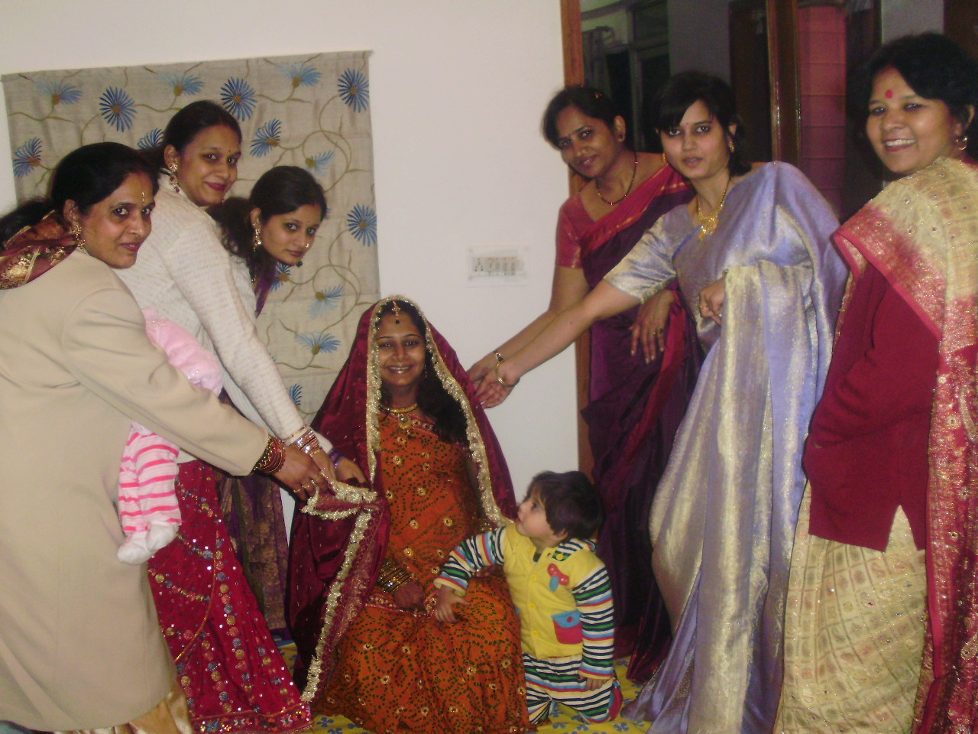
All married women make the mom-2 be wear a red Stole/Chunri.

Slide 6
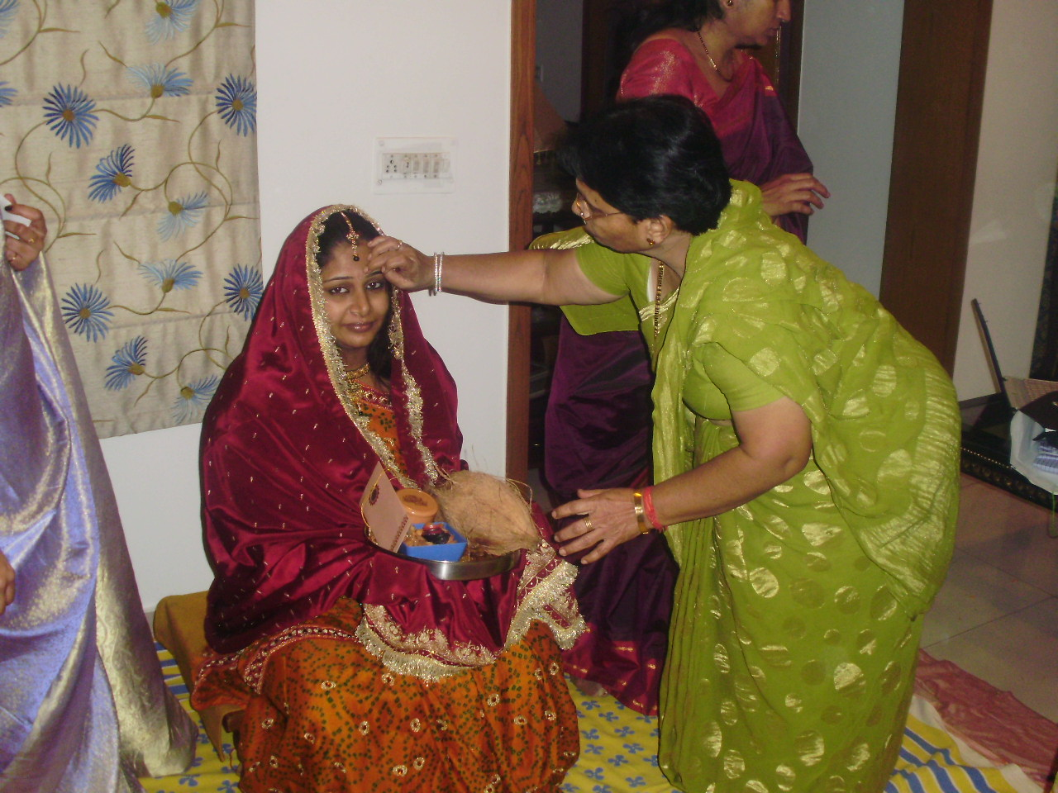
Dry fruits,Gold,cash,clothes being given to themom-2-be

Slide 7
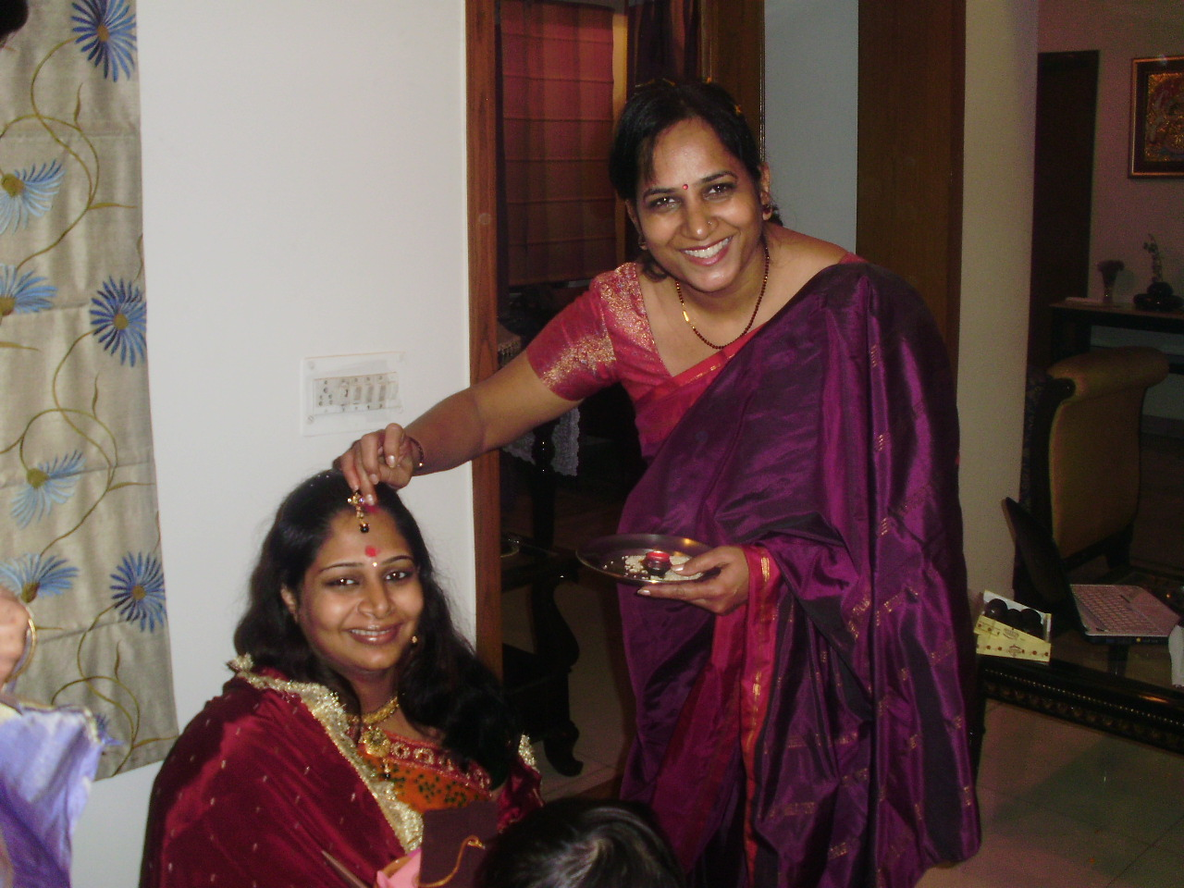

Slide 8
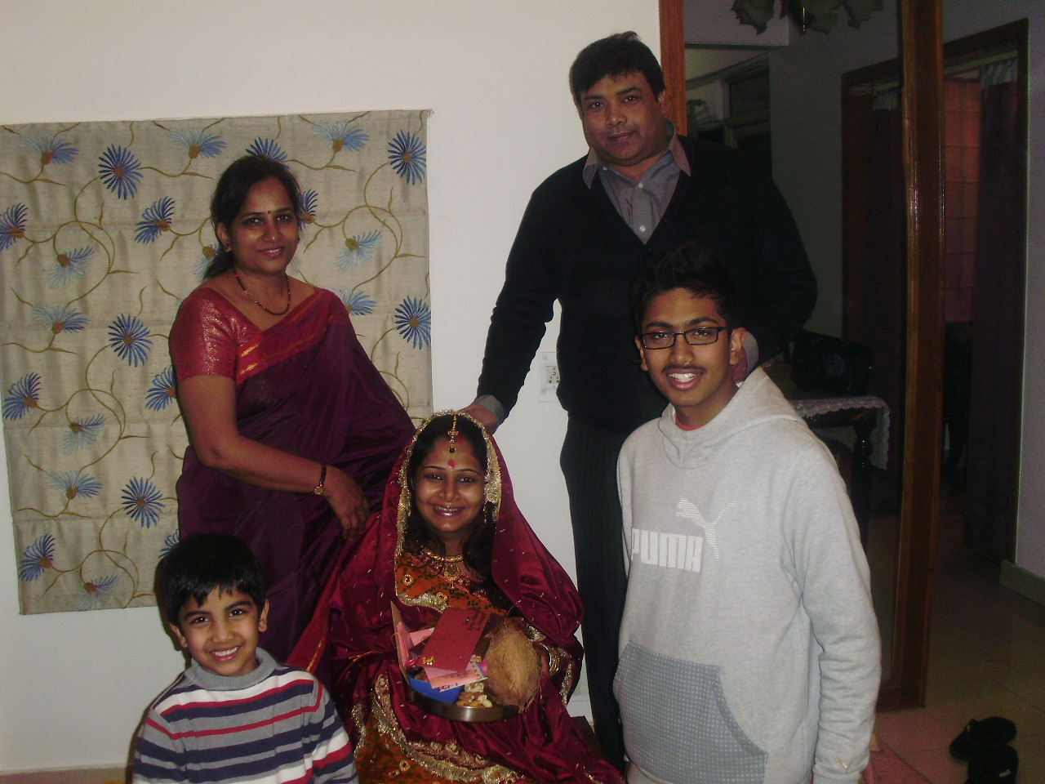
Elders of the family bless

Slide 9
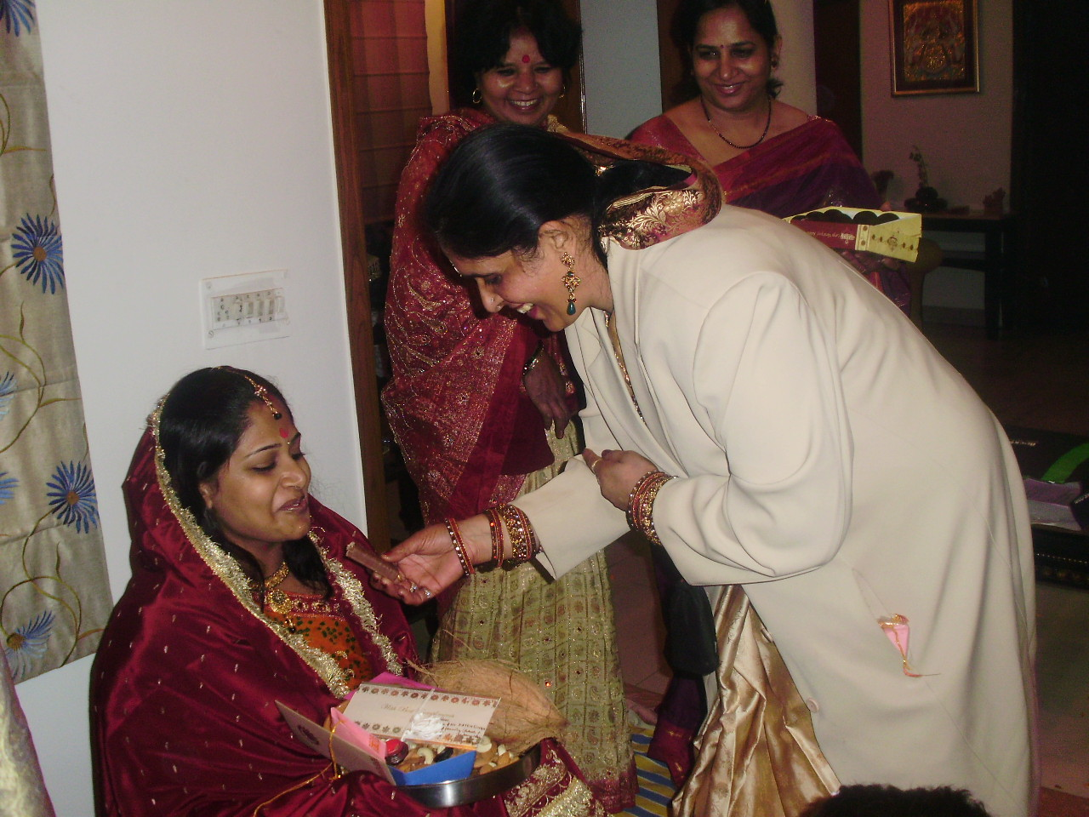
Made to eat lots and lots of sweets.

Slide 10
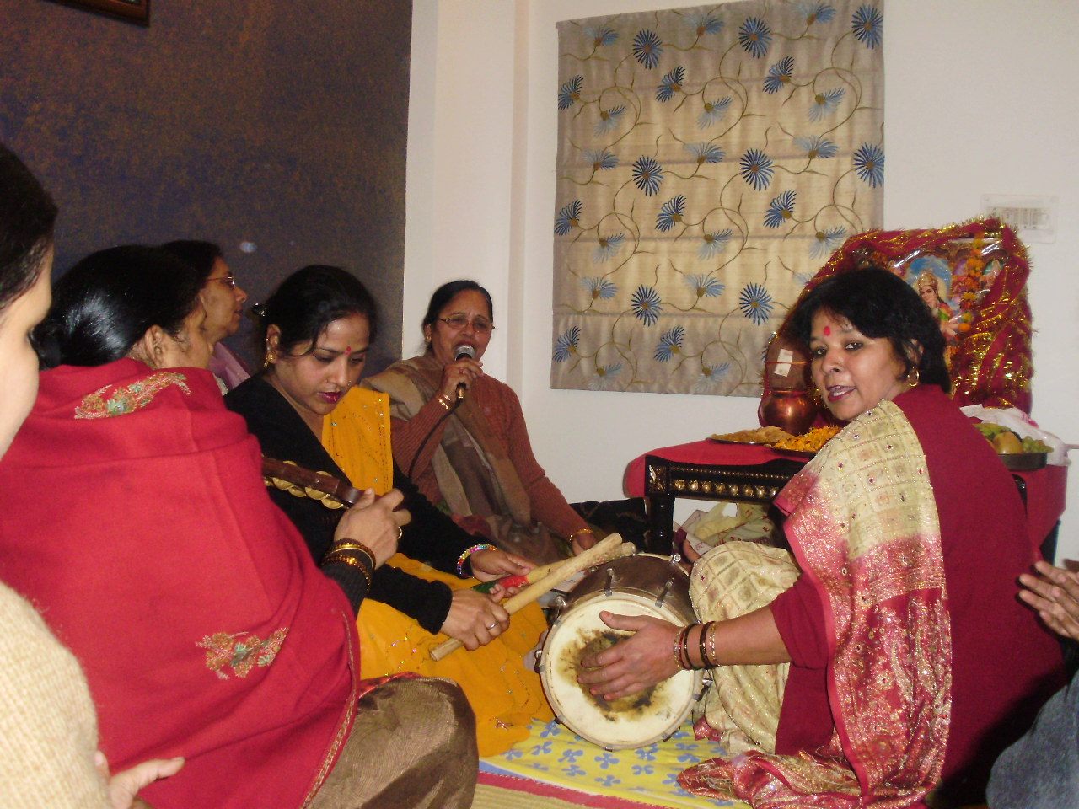
Dance and music

