Slide 1
The Rivers Of France:
The Loire and The Seine
By Advik Iyer Guha
Class 10
Sishu Griha

Slide 2
The Important Rivers of France
Loire (1,010 km)
Seine (770 km)
Garonne (650 km)
Rhone(522 km)
Notes:
France is home to several well-known rivers, such as the Rhone, Rhine, Saone, Siene, Loire and Garonne rivers to name a few. Among most important rivers, which form the backbone of France's water system, include the Loire (1,010 km), the Seine (770 km), the Garonne (650 km) and the Rhone(522 km).

Slide 3
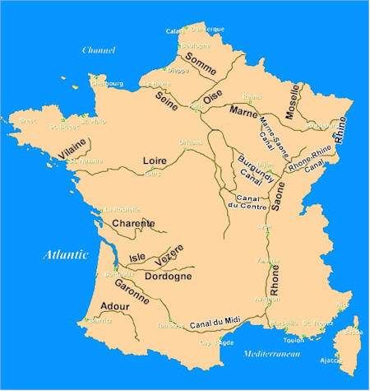
The Rivers of France

Slide 4
The Importance of Rivers
Important medium for transport and for industrial and urban development.
Offer ideal conditions for recreation: Barge cruising, sailing, whitewater rafting etc.
Backbone of France's water system

Slide 5
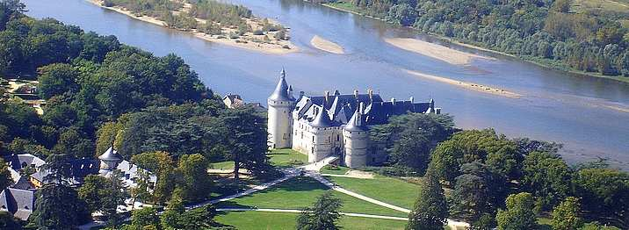
The Loire River
The longest river in France

Slide 6
Introduction
It rises in the southern Massif Central (Cévennes) and flows north and west for 1,020 km.
Flows into the Atlantic Ocean, and enters south of the Bretagne peninsula.
Its major tributary is the Allier.
It drains an area of about 45,000 square miles (117,000 square km).
Notes:
longest river in France, rising in the southern Massif Central and flowing north and west for 634 miles (1,020 km) to the Atlantic Ocean, which it enters south of the Bretagne (Brittany) peninsula. Its major tributary is the Allier, which is one of the rare places in Southern Europe where the freshwater grayling occurs in a natural habitat. They are economically important, being appreciated for food and fished for sport.
The allier joins the Loire at Le Bec d’Allier. Its drains an area of about 45,000 square miles (117,000 square km). The picturesque valley is dotted with châteaus.

Slide 7
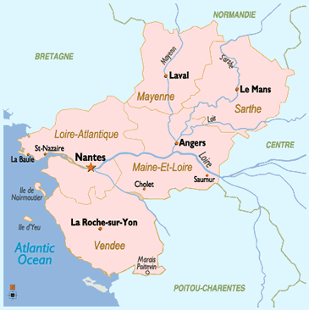

Slide 8
Upper Course
Flows through a succession of downfaulted, flat-floored basins set in the highlands of the Massif Central.
After being joined by the Allier, the greatly enlarged stream flows across the limestone platform of Berry, and its valley becomes only a slight groove.
The upper course of the Loire tends to flow north toward the centre of the Paris Basin, but it then flows westward to the sea by its long estuary at Nantes.
Notes:
n estuary is a semi-enclosed coastal body of water with one or more rivers or streamsflowing into it, and with a free connection to the open sea. They are affected by both marine influences, such as tides, waves, and the influx of saline water; and riverine influences, such as flows of fresh water and sediment. As a result they may contain many biological niches within a small area, and so are associated with high biological diversity.

Slide 9
Climate in the Basin
The Loire Basin has a temperate maritime climate, with no consistent dry season and with heavy precipitation in its upper basin.
It is also subject to violent autumn storms from the Mediterranean.\
The river is highest in late winter; floods may occur in any month, though normally not in July and August.
Notes:
The Loire Basin has a temperate maritime climate, with no consistentdry season and with heavy precipitation, including winter snowfall, in the highlands that occupy its upper basin.
The area of its headwaters is also subject to violent autumn storms from the Mediterranean. The river is usually highest in late winter, but there is no reliable rule; floods may occur in any month, though normally not in July and August.

Slide 10
Change in Use of river
In its middle course, it is a shallow but steep-sided groove. Its once-marshy floodplain is protected from flooding by levées(“embankments”)
Effective agricultural reclamation began in the 14th century and was stimulated in the 15th and 16th centuries.
In the 18th century, the river was the great highway for movement of goods, and the cities on its banks were busy ports.
Notes:
Effective agricultural reclamation began in the 14th century and was stimulated by the presence of the French court in the 15th and 16th centuries, when the middle Loire valley sustained a strip of land intensively cultivated for cash crops. In the 18th century, before the French Revolution, it reached the peak of its prosperity. The river was the great highway for movement of goods, and the cities on its banks were busy ports.

Slide 11
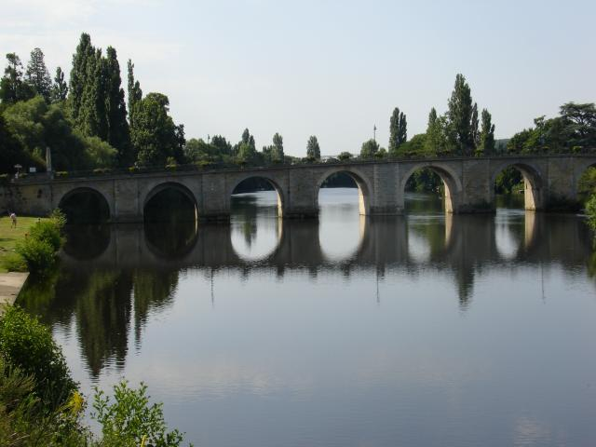

Slide 12
Change in Use of river
During the period of developing river traffic, canal links were built connecting the Loire with the Seine system, which allowed products to be carried to Paris.
These connecting canals are too narrow for modern vessels, and their use is limited.
Left behind by modern developments, the Loire countryside remains predominantly rural, Old World, and little affected by modern industry.
Notes:
During the period of developing river traffic in the 17th and 18th centuries, canal links were built connecting the Loire navigation with the Seine system of navigable waterways, which allowed products to be carried to Paris. These connecting canals are too narrow for modern vessels, and their use is limited. Left behind by modern developments, the Loire countryside remains predominantly rural, Old World, and little affected by modern industry.

Slide 13
Change in Use of river
During the 19th century, the Loire River transported approximately 1843,70,000 people with the use of steam-driven boats, however the implementation of rail systems saw the decline in the navigational use.
UNESCO adorned the stretch of river between Maine and Sully-sur-Loire as a World Heritage site.
It was recognised for its exquisite, cultural landscape - boasting exceptional views of many historical cities, the magnificent chateaux of the Loire Valley and pastoral lands which have been fashioned by centuries of agricultural practices.

Slide 14
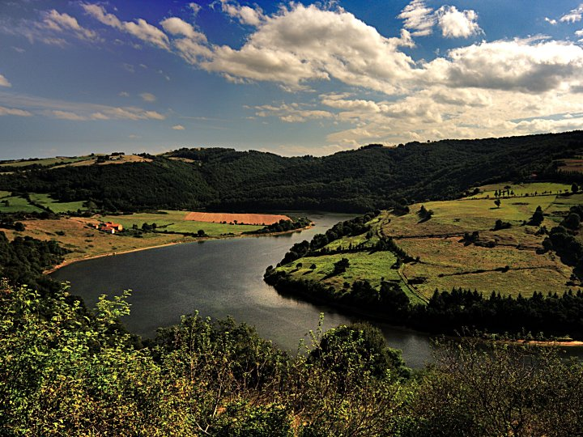
The Loire River

Slide 15
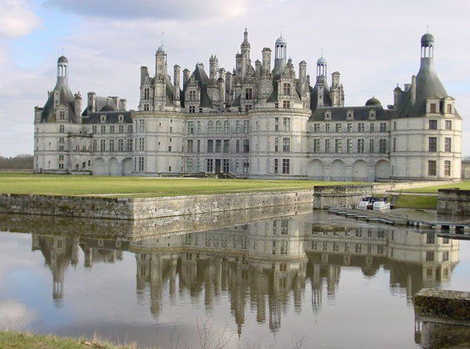
The chateaux de la Loire

Slide 16
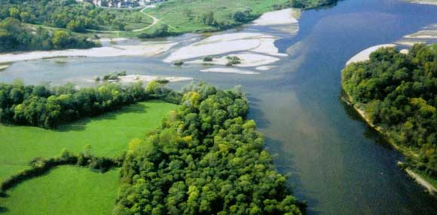

Slide 17
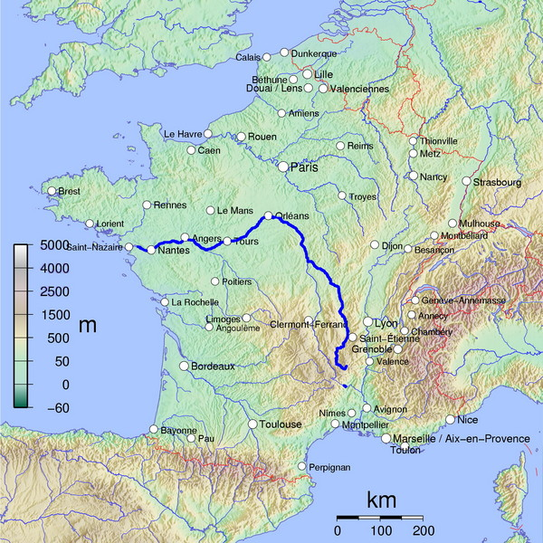

Slide 18
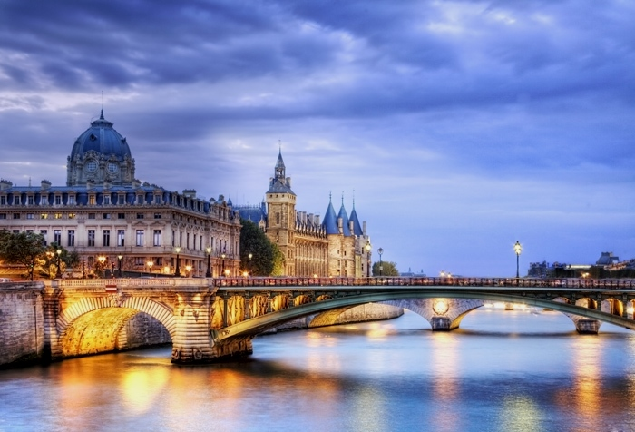
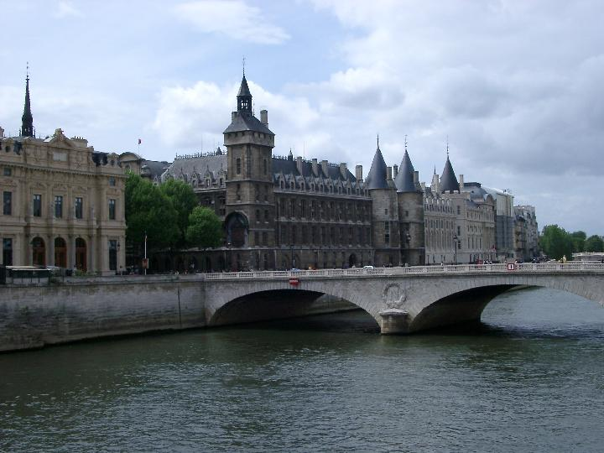
The Seine River
the second longest river in France

Slide 19
Introduction
The Seine River rises on the Langres plateau, 18 mi (30 km) northwest of Dijon, and flows through downtown Paris.
It empties into the English Channel at Le Havre after a course of 485 mi (780 km).
Its tributaries include the Marne and Oise rivers.
It drains an area of about 30,400 sq mi (78,700 sq km) in northern France.
Its network carries most of France’s inland waterway traffic due to its calm stream and great volume of water.
Notes:
Dijon: capital of Burgundy

Slide 20
Introduction
Until 19th century, one could find "water sellers" drawing water from the Seine and carrying it to each household.
It serves as a watercourse that carries down an enormous quantity of sewage water of the city;
After 19th century, the river improvements of large scale, such as building lock gates, dredging and shoreline protection works, were carried out and the Seine became the way we see it today.
The Seine has inspired countless chansons, paintings, and literature.
Notes:
2nd bullet: well developed network of sewage system of Paris is famous.

Slide 21
Physical features » Physiography
The Seine rises at 1,545 feet (471 metres) above sea level in Burgundy.
Flowing northwest, it enters Champagne above Troyes and traverses the dry chalk plateau in a well-defined trench.
Joined by the Aube near Romilly, and it receives the Yonne at Montereau.
Turning northwest again, the Seine crosses the Île-de-France toward Paris.
As it enters Paris, it is joined by its great tributary the Marne on the right, and, after traversing the metropolis, it receives the Oise, also on the right.
In its passage through Paris, the river has been trained and narrowed between riverside quays. the Seine passes below Mantes-la-Jolie across Normandy toward its estuary in the English Channel.
Notes:
This divide by the River Seine through Paris is what gives the city its distinct, geographic division. For instance, the Eiffel Tower and the Musee d'Orsayare on the south bank, whilst the Louvre, Grand Palais, and the Concorde can be found on the north bank. In the centre of Paris on the Ile de la Cite in the middle of the Seine River, you will find the Notre Dame Cathedral among other monuments.

Slide 22
The Economy
The Seine, especially below Paris, is a great traffic highway.
It links Paris with the sea and the huge maritime port of Le Havre.
Vessels drawing up to 10 feet (3.2 metres) can reach the quays of Paris.
The lower Seine system is connected with that of the Rhine by way of the Marne, and the Oise links it with the waterways of Belgium. The links with the Loire waterway and with the Saône-Rhône, dating from the 17th and 18th centuries when connecting canals were built, are now of minor importance.
The water of the Seine is an important resource for the riverine population.
Large electric power stations, both thermal and nuclear, draw their cooling water from the river.
In addition, half of the water used in the region around Paris, both for industry and for human consumption, and three-fourths of the water used in the region between Rouen and Le Havre, is taken from the river.
Notes:
Most of the traffic, which chiefly consists of heavy petroleum products and building materials, passes upstream to the main facilities of the port of Paris at Gennevilliers.
When Paris prospered through extensive river trading and expanded to the Left Bank in the days of the Roman Empire, the Seine became a great commercial artery, which was linked by canals to the River Loire, River Rhine, and the River Rhone.

Slide 23
Development of the river
Although the regime of the Seine is relatively moderate, improvements have been considered necessary since the beginning of the 19th century.
To improve navigation, the water level was raised by means of dams and by storage reservoirs.
Lake Settons, originally designed for the flotation of wood, and other reservoirs have proved useful in reducing floods as well as in ensuring a constant water supply in summer.
Upstream from the basin four large storage reservoirs have been built since 1950 on the Yonne, Marne, and Aube, as well as on the Seine itself.
The Seine Reservoir, for example, covers some 6,175 acres, while the Marne Reservoir, with an area of about 11,900 acres, is the largest artificial lake in western Europe.
Surrounded by woodland and countryside, these reservoirs have become bird sanctuaries and tourist attractions in a new nature reserve.

Slide 24
Environmental Aspect
The Seine used to be heavily polluted, with many factories dumping their waste directly into the river.
By the 1950s there were only four or five species of fish left.
Strict environmental regulations and water treatment technology have cleaned up the river.
Today there are over three dozen species of fish (silver carp, catfish, pike perch, eels) and an abundance of aquatic birds and plants.
The Seine is still used by commercial shipping barges, although most of the boats passing under the scenic bridges of Paris are pleasure craft – such as sightseeing or dinner cruises.

Slide 25
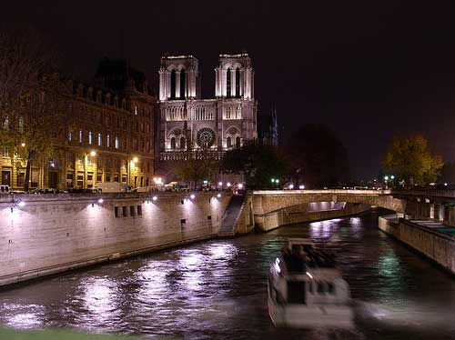
The Notre Dame Cathedral
During the early 19th century, the cathedral was in a state of disrepair, and city planners began to contemplate tearing it down. French novelist Victor Hugo, an admirer of the cathedral, wrote his novel The Hunchback of Notre Dame (originally titled Notre Dame de Paris) in part to raise awareness of the cathedral's heritage, which sparked renewed interest in the cathedral's fate. A campaign to collect funds to save the cathedral followed, culminating in the 1845 restorations.

Slide 26
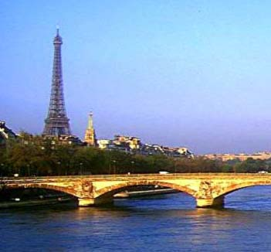
The Eiffel tower
The Eiffel Tower (French: Tour Eiffel) is an iron tower built on the Champ de Mars beside the Seine River in Paris. The tower has become a global icon of France and is one of the Wonders of the modern world.

Slide 27
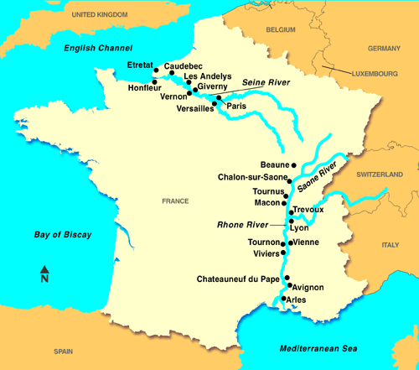
Seine River Map
Below is the map of the Seine and the Rhone river

Slide 28
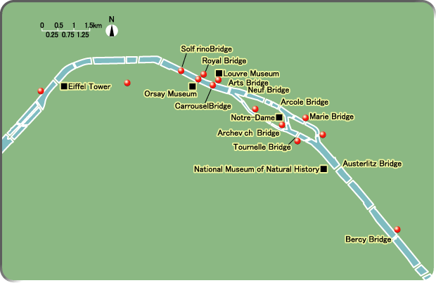
The Path of the Seine River

Slide 29
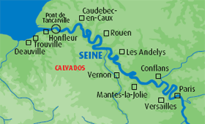

Slide 30
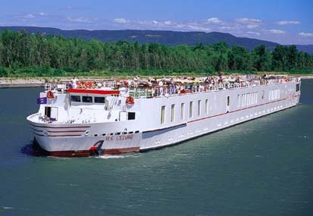
A cruise boat on The Seine

Slide 31
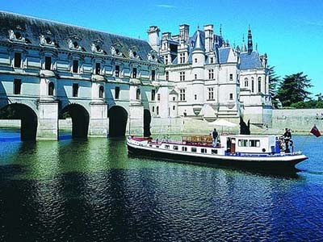

Slide 32
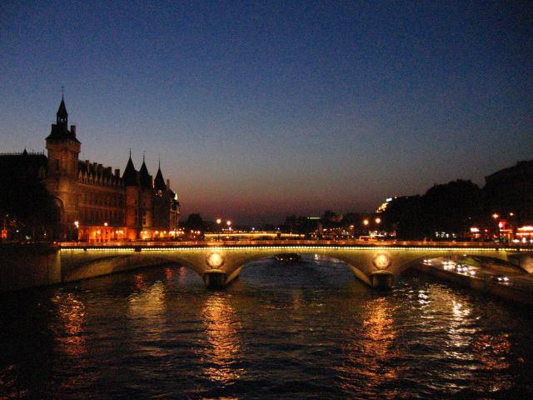
The Seine at night

