Slide 1
WATER CONSERVATION

Slide 2
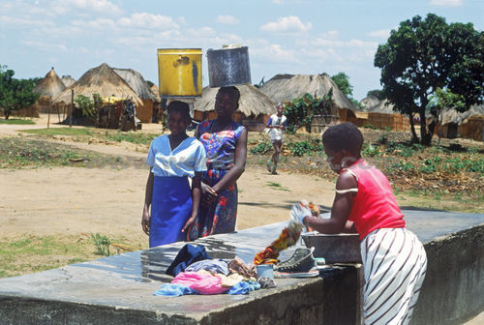
Water is precious, save it. We can use water for so many things like – washing clothes, bathing,
cooking food, drinking etc. We are wasting so
much of water and instead of wasting water we can save it.

Slide 3
How can we save water?
Don’t leave the tap open.
Don’t use shower while bathing, use only a bucket to bath.
We can save rainy water by big tanks like- in Rajasthan.

Slide 4
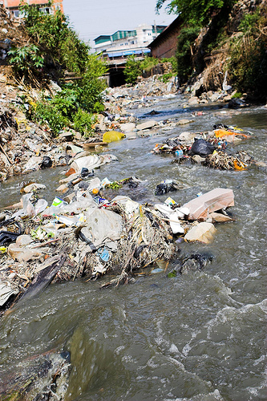
Waste water
Water is being polluted by lot of garbage

Slide 5
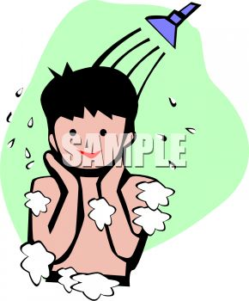
Don’ t take shower bath.

Slide 6
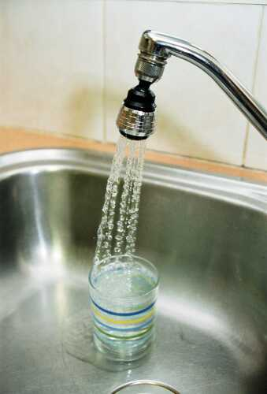
Don’t leave the tap open

Slide 7
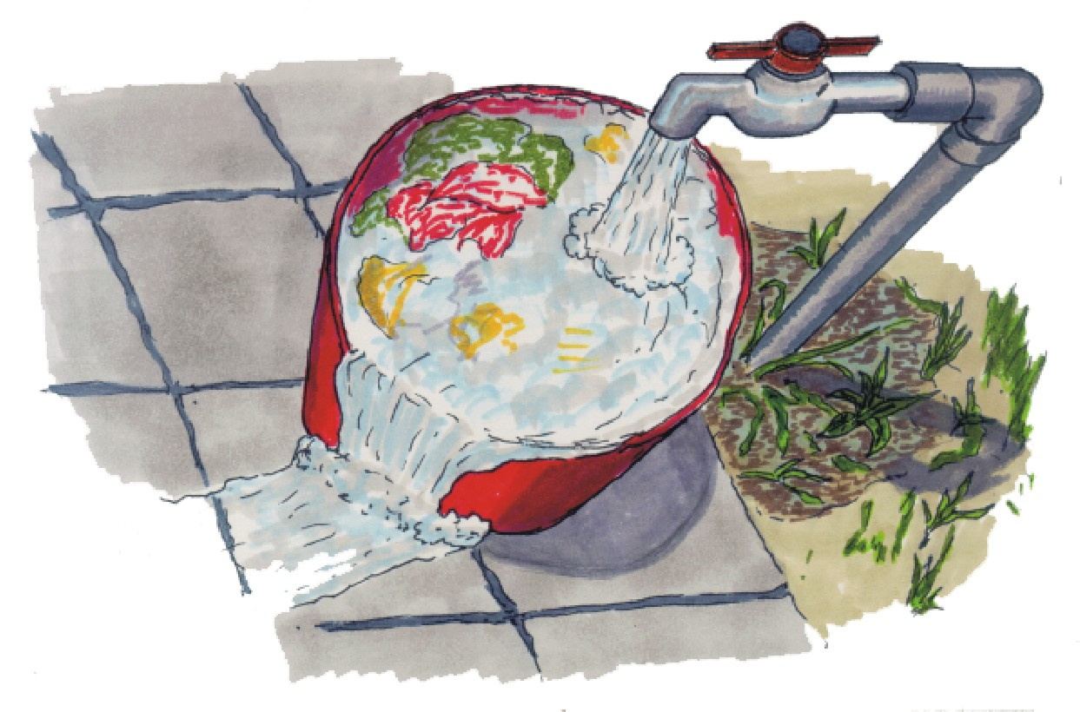
don’t leave the tap open while filling the bucket

Slide 8
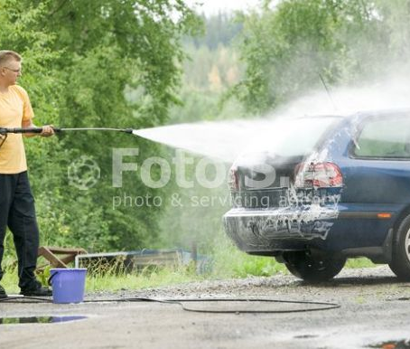
don’t use pipe while washing a car

Slide 9
p.p.t
Made by
Vivek barnwal
Std-V

