Slide 1
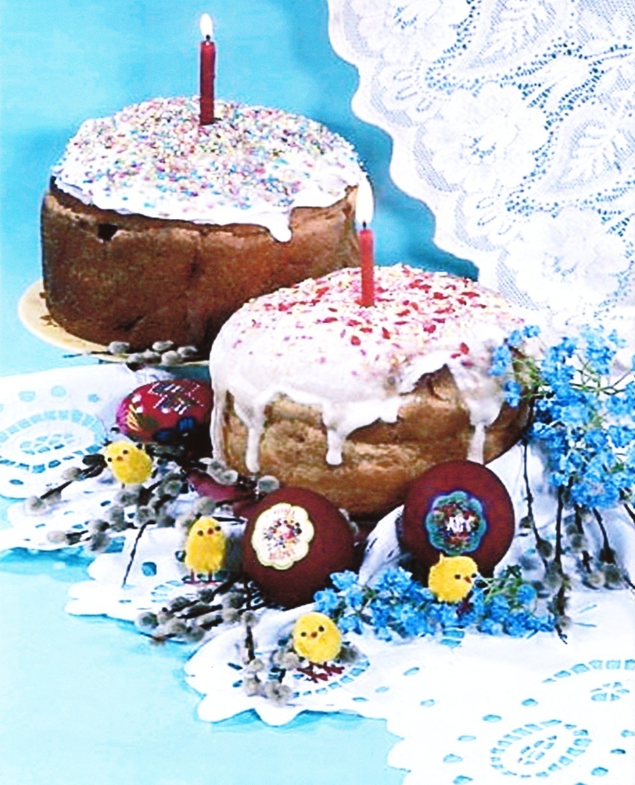
Easter Traditions
In Ukraine Easter has many rich traditions. Traditionally people bake special bread called paska and paint eggs called pysanky or krashanky.
A paschal cake (“paska”) is baked at Easter time. In different regions of Ukraine people have their traditional recipes of making Easter cakes as well as every hostess has got her personal secrets - either with soft cheese or raisins, or with vanilla or decorated.

Slide 2
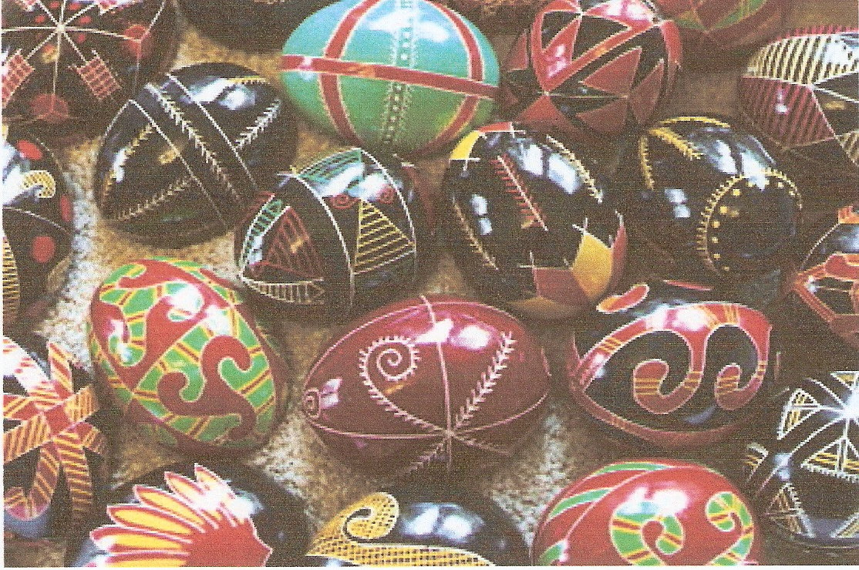
Pysanky
Ukrainian eggs, or pysanky, are a part of a rich history of tradition in Ukrainian culture. They are an integral part of Ukrainians` cultural heritage and ritualistic practices. Ukrainians believe that pysanky are responsible for keeping evil from taking over the world. Ukrainian “pysanky” have a symbolic significance. They symbolize spring renewed life and resurrection and have thus become associated with the celebration of Easter.

Slide 3
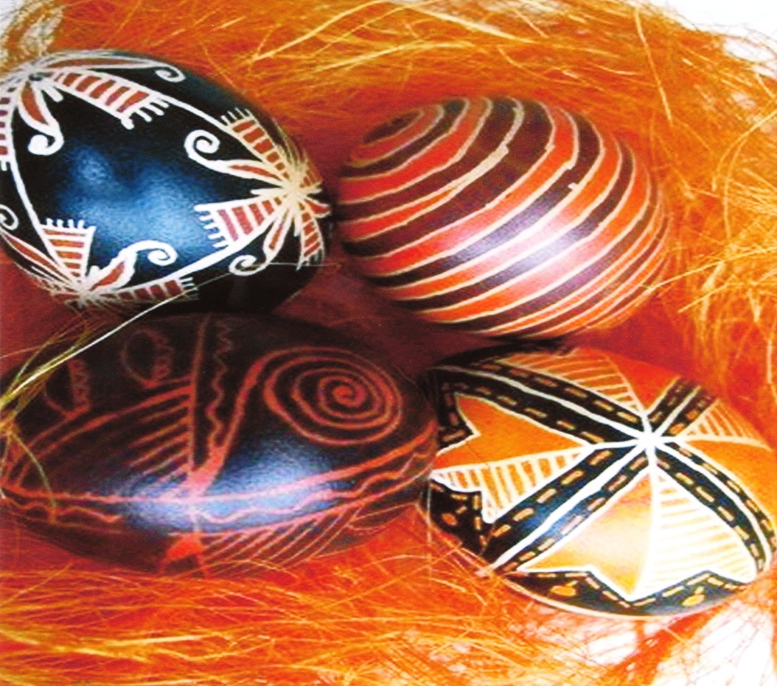
How Pysanky are decorated
Pysanky are coloured using natural dyes from fruits, vegetables, flowers, leaves and bark. Symbols and decorations are passed from generation to generation. They can be made of various materials – poultry (usually chicken) eggs, stone, wood or clay and can be decorated by various techniques – by painting with a brush (malyovanka), by dying the egg a solid colour (krashanka), by dripping hot wax on the egg before dying it (krapanka), or by scratching a design on a dyed egg (dryapanka).
Decorating Easter eggs has been a great art for many years. Women and children paint designs with beeswax on an egg, they dye the egg. They melt away the wax after the dye has dried. When the beeswax melts away, the design is the colour of the egg. They dye the eggs with food colouring or Easter egg dye. After the eggs are dry, more decorations can be added with stickers and felt-tip pens.

Slide 4
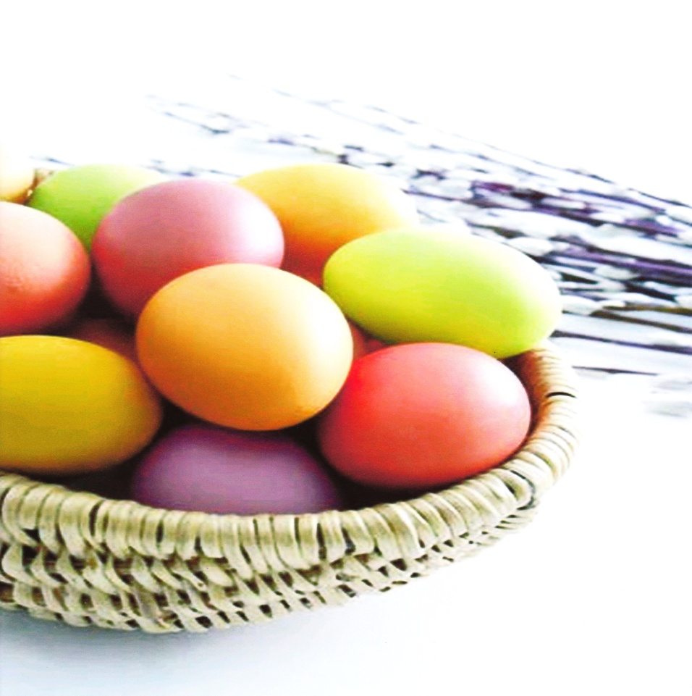
Legends
The Hutsuls – Ukrainians who live in the Carpathian Mountains of western Ukraine – believe that the fate of the world depends upon the pysanky. As long as the egg decorating custom continues, the world will exist. If for any reason, this custom is abandoned, evil – in the shape of a horrible serpent that is forever chained to a cliff – will overrun the world. Each year the serpent sends out his minions to see how many pysanky have been created. If the number is low the serpent`s chains are loosened and he is free to wander the earth causing havoc and destruction. If, on the other hand, the number of pysanky has increased, the chains are tightened and good triumphs over evil for yet another year.
Never legends blended folklore and Christian beliefs and firmly attached the egg to the Easter celebration. One legend concerns the Virgin Mary. It tells of the time Mary gave eggs to the soldiers at the cross. She entreated them to be less cruel to her son and she cried. The tears of Mary fell upon the eggs, spotting them with dots of brilliant colour.

Slide 5
How Pysanky Are Used
Ukrainian eggs are given to relatives, friends and respected members.They can be placed around the house for protection, arranged at the graves of loved ones, and used around family farms to promote good harvests, healthy livestock, and prosperous beehives.
People bless paska, eggs and other food in the church. Butter, lard, cheese , sausage, smoked meat and poppy seeds, millet, pepper, horseradish are also blessed.
After the service the people greet each other, give each other “krashanky” and then hurry home with their baskets of blessed food. Then the family has the holiday breakfast. It starts with a prayer and traditional Easter greeting: “Christos voskres” (Jesus is risen). The answer is “Voistenno voskres” (Truly risen). After this greeting, people kiss each other three times. This greeting is said all Sunday and for several more days if people hadn`t greeted each other since Easter.
The first part of the meal is a slice of paska. Then children play navbytky, hit their Easter eggs to see whose is stronger. The one whose egg doesn`t crack wins.
Related to the exchange of “krashanky” is the rite of sprinkling with water, which is still carried on in Western Ukraine on the second day of Easter (Wet Monday, Oblyvany Ponedilok); it`s practiced by young people splashing the girls with water. Easter Monday is also a holiday in Ukraine. All the financial institutions, offices and shops are closed on these days. During this day children visit their grandparents and godparents and bring them paska and eggs

Slide 6
Works made by the students of Chernivtsi school #6
Ukraine

