Slide 1

This is my first lesson with power point
1 L scuola secondaria di primo grado Bonito Cosenza of Castellammare di stabia

Slide 2
Our School Subjects
Italian
History
Geography
Maths
Science
Enghish
French
P.E.
Religiuos Studies
Art
Tecnology
Music

Slide 3
My Daily Routine
By Annapaola ^_^
By Alessandra <3
I usually get up a quarter past seven
I leave home at eight o’ clock with Annapaola ^_^
My lesson starts at a quarter past eight
I have a break at a quarter past ten
My lesson finish at quarter past one
After lunch I play pc
I go to bed at eleven o’ clock

Slide 4
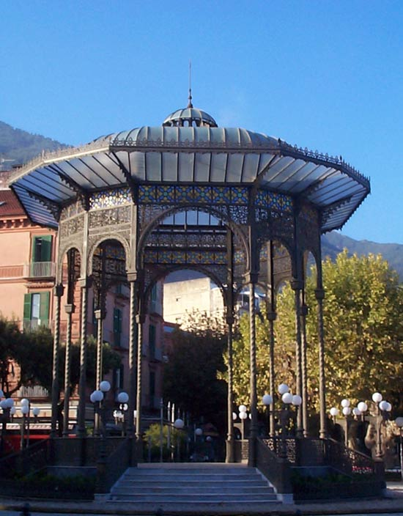
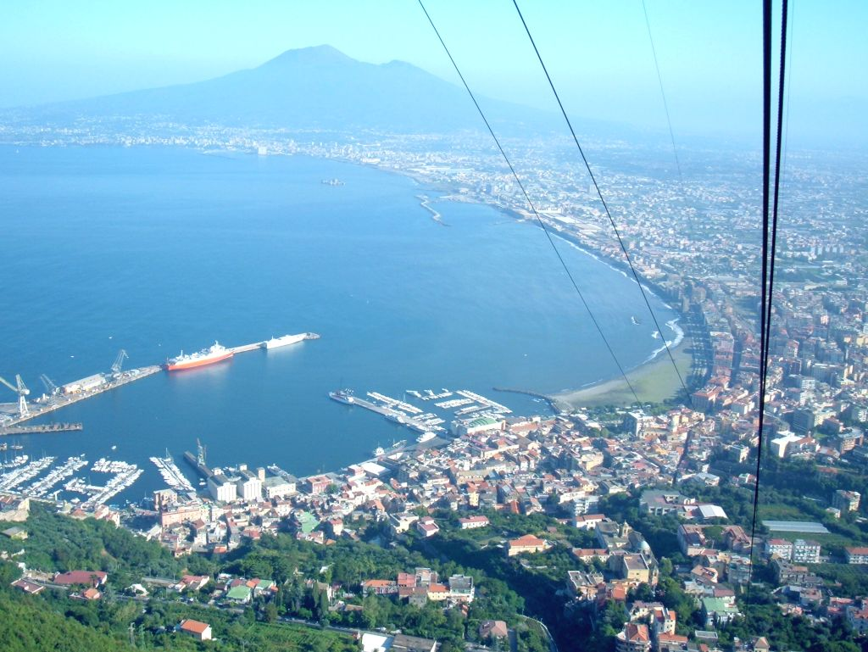
Wath I like about Castellammare di Stabia
By Annapaola ^_^ and Alessandra<3

Slide 5
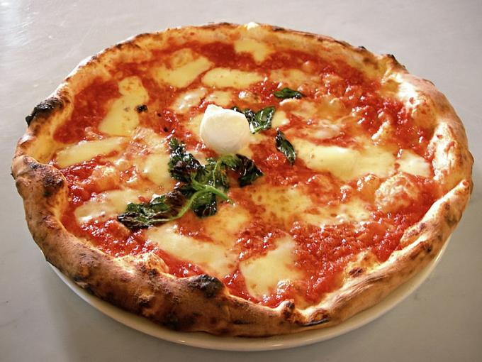
<3 our FAVOURITE PIZZA <3
Our like pizza. ^______________________________________^
by AnNaPaOlA ^_^ AlEsSaNdRa <3

Slide 6
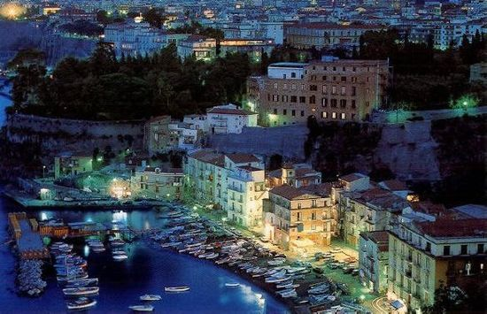
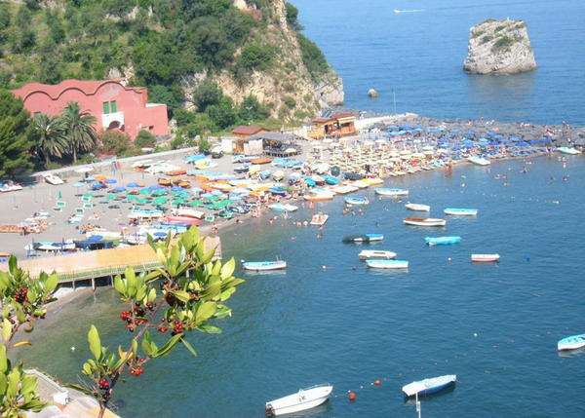
Beaches near Castellammare di Stabia
There are many warm and fun beaches in Castellammare to go and to go…
Sorrento and Vico Equense
.

Slide 7
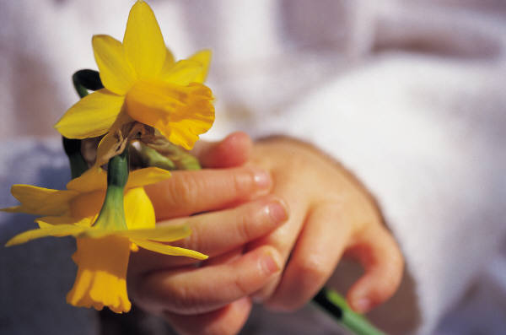
The End…
Bye

